Slide 1
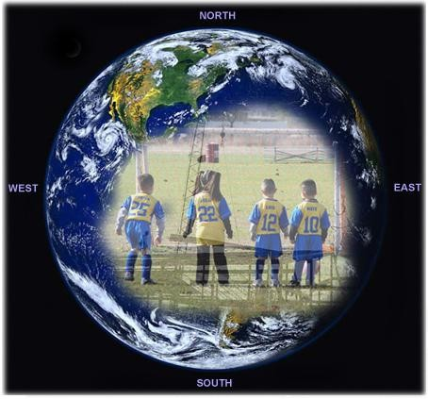
Big Four Construction Hazards: Fall Hazards
This material was produced under grant number SH-17792-08-60-F-48 Occupational Safety and Health Administration, U.S. Department of Labor. It does not necessarily reflect the views or policies of the U.S. Department of Labor, nor does mention of trade names, commercial products, or organizations imply endorsement by the U.S. Government.
Revision were made to this material under grant number SH-05022-SH8 from the Occupational Safety and Health Administration, U.S. Department of Labor.

Slide 2
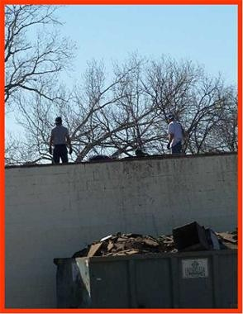
Hazards

Slide 3
Building Structures
Work conditions 6’ or more above lower level require the use of fall protection:
Unprotected sides, edges
Leading edges
Excavations
Walking/working surfaces

Slide 4
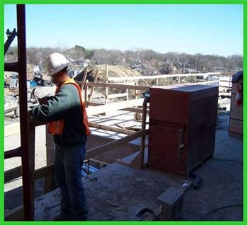
Building Structures
Damaged or missing guardrails must be fixed immediately.

Slide 5
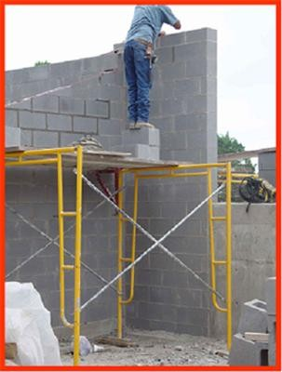
Hazards

Slide 6
Scaffolds
Never stack blocks, bricks, or use ladders on top of scaffolds for extra height.

Slide 7
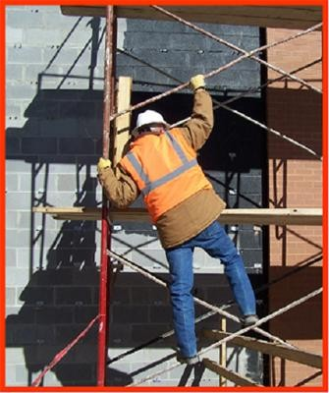
Scaffolds

Slide 8
Scaffolds
Workers must have a safe way to access the scaffold.

Slide 9
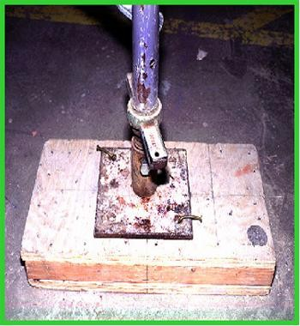
Scaffolds
Scaffold bases must rest on a base plate and a mud sill.
Base plate
The base plate is designed to level and support the scaffold.
Mud sill

Slide 10
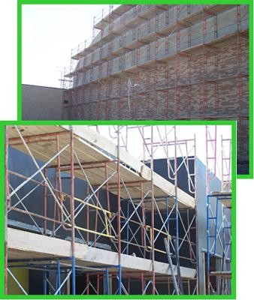
Scaffolds
Scaffolds are elevated, temporary work platforms:
Supported scaffold
Guardrails
Access ladders
Powered work platforms

Slide 11
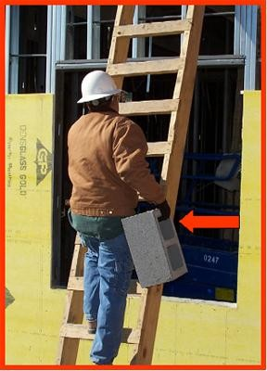
Hazards

Slide 12
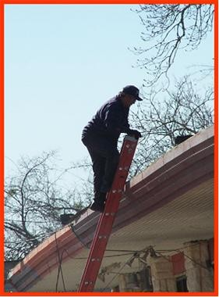
Ladders

Slide 13
Ladders
When using a portable ladder for access to an upper landing surface, the side rails must extend at least 3’ above the upper landing surface.

Slide 14
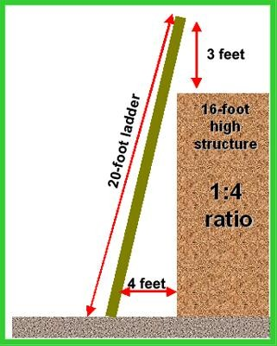
Ladders
Ladders must be positioned at a safe angle to avoid potential fall hazards when climbing.
Extension ladders must extend 3’ over the landing for safe access.

Slide 15
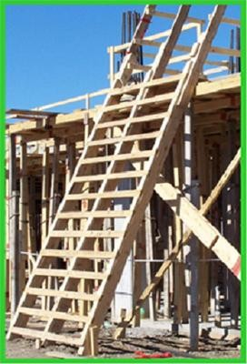
Job Made Ladders
Job made ladders must be properly constructed:
Steps equally spaced
No missing steps or rungs
No sharp edges or
nails sticking out

Slide 16
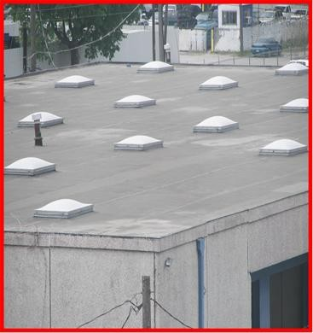
Floor Covers

Slide 17
Floor Covers
Sky-lights are another form of floor holes.
Never sit, stand, or place any materials on sky-lights.

Slide 18
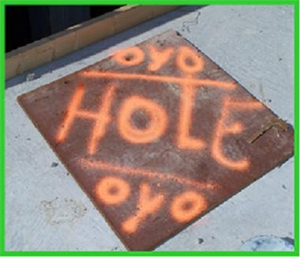
Floor Covers
The cover must be marked to make sure everyone knows it is a safety device.

Slide 19
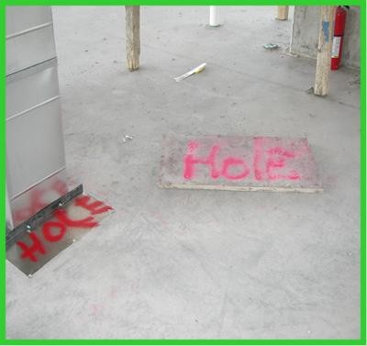
Floor Covers
All floor holes where an employee could fall through must be covered or guarded.

