Slide 1
Legislative and Public Policy Committee Meeting
RHCA . . . the leader in Diversity Inclusion
Networking and building business relationships and opportunities
March 10, 2023
Disclaimer: This webinar is not intended for press purposes. If you are part the press, please disconnect.
Join us on Social Media #DFWRHCA @DFWRHCA

Slide 2
Housekeeping Rules
Keep yourself muted throughout the meeting
Please make sure to stay for the whole meeting
Presentation will be emailed
Q&A will be after each presentation
Ask questions in the chat
Please make sure to keep your camera on, at all times
If you get logged out, please re-login using the same link
Join us on Social Media #DFWRHCA @DFWRHCA

Slide 3
Welcome
Join us on Social Media #DFWRHCA @DFWRHCA

Slide 4
Committee Discussions
Join us on Social Media #DFWRHCA @DFWRHCA

Slide 5
Committee Discussions
Statewide Initiative
Project Opportunities
Legislative
2023 – 2024 Texas 88th Legislative Strategic Agenda A Public Policy Platform
Tracking Bills
88th Legislative Bill Tracker – Comprehensive – Excel
Platform as guide
Testimony
Develop letter template
Hearings
Legislative Hearings & Subcommittee Roles
2023 – 2024 Advocacy Platform
Join us on Social Media #DFWRHCA @DFWRHCA

Slide 6
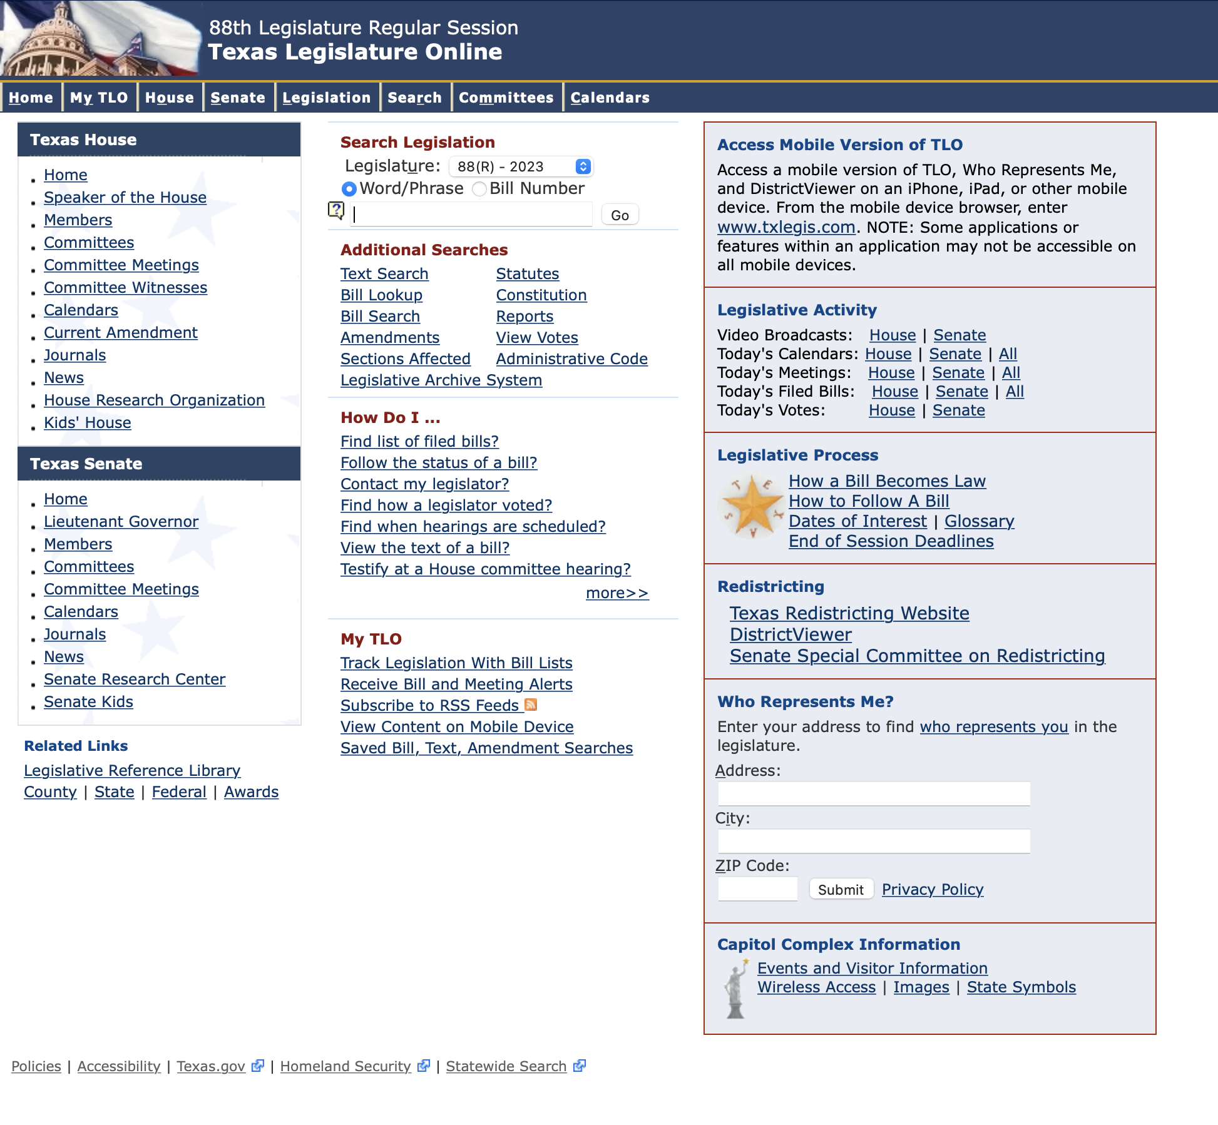
Committee Discussions
TLO: https://capitol.texas.gov/Home.aspx
Join us on Social Media #DFWRHCA @DFWRHCA

Slide 7
Committee Discussions
Open Discussion
Market Conditions
Creating of Subcommittees
Weekly Friday meetings to review bills
Fridays 9:00 am – 9:30 am
Safety
Workforce Development and Labor
Economic Development and Inclusion
Other____
Join us on Social Media #DFWRHCA @DFWRHCA

Slide 8
https://form.jotform.com/230316866695062
Join us on Social Media #DFWRHCA @DFWRHCA

Slide 9
Registration: http://events.r20.constantcontact.com/register/event?oeidk=a07ejmz97itb791f0ae&llr=ymfrebdab
Construction Worker of the Year Nominations: https://rhca.awardsplatform.com
Join us on Social Media #DFWRHCA @DFWRHCA

Slide 10
Registration: https://form.jotform.com/230454822103142
Worker of the Year Nominations: https://form.jotform.com/230236984656061
Sponsorship Opportunities: https://form.jotform.com/230305221953042
Join us on Social Media #DFWRHCA @DFWRHCA

Slide 11
https://regionalhca.org/city-of-fort-worth-contractors-capacity-development-program-english-2/
Join us on Social Media #DFWRHCA @DFWRHCA

Slide 12
https://regionalhca.org/city-of-fort-worth-contractors-capacity-development-program-spanish/
Join us on Social Media #DFWRHCA @DFWRHCA

Slide 13
https://form.jotform.com/230506219443147
Join us on Social Media #DFWRHCA @DFWRHCA

Slide 14
https://form.jotform.com/230506679637162
Join us on Social Media #DFWRHCA @DFWRHCA

Slide 15
https://form.jotform.com/223546066396160
Join us on Social Media #DFWRHCA @DFWRHCA

Slide 16
https://form.jotform.com/222965555456164
Join us on Social Media #DFWRHCA @DFWRHCA

Slide 17
https://form.jotform.com/230085618271151
Join us on Social Media #DFWRHCA @DFWRHCA

Slide 18
RHCA | Subcommittee
Help with inviting monthly guest speakers
Example:
The invitation details are listed below:
Date: Wednesday, February 14, 2022
Time Duration: 20 minutes (if you need more, please let me know)
Time Range: Any 20 minutes between 8:45am to 10:00am CST
Via online Video: Zoom Video Conference
Committee: RHCA Legislative and Public Policy: Audience – Contractors/Professional Services/Public Agency Employees/Small Business Owners
Topic: How the 2020 Census Data is used for Redistricting and the impact it has to you personally and your business
Presentation: PowerPoint Due by Monday, February 14
Other Items Needed: (1) Headshot in JPEG (2) Title (3) Bio
Join us on Social Media #DFWRHCA @DFWRHCA

Slide 19
Q & A
Join us on Social Media #DFWRHCA @DFWRHCA

