Slide 1
Legislative and Public Policy Committee Meeting
RHCA . . . the leader in Diversity Inclusion
Networking and building business relationships and opportunities
April 14, 2023
Disclaimer: This webinar is not intended for press purposes. If you are part the press, please disconnect.
Join us on Social Media #DFWRHCA @DFWRHCA

Slide 2
Housekeeping Rules
Keep yourself muted throughout the meeting
Please make sure to stay for the whole meeting
Presentation will be emailed
Q&A will be after each presentation
Ask questions in the chat
Please make sure to keep your camera on, at all times
If you get logged out, please re-login using the same link
Join us on Social Media #DFWRHCA @DFWRHCA

Slide 3
Welcome
Join us on Social Media #DFWRHCA @DFWRHCA

Slide 4
Committee Discussions
Join us on Social Media #DFWRHCA @DFWRHCA

Slide 5
Committee Discussions
Statewide Initiative
Project Opportunities
Legislative
2023 – 2024 Texas 88th Legislative Strategic Agenda A Public Policy Platform
Tracking Bills
88th Legislative Bill Tracker – Comprehensive – Excel
Platform as guide
Testimony
Develop letter template
Hearings
Legislative Hearings & Subcommittee Roles
2023 – 2024 Advocacy Platform
Join us on Social Media #DFWRHCA @DFWRHCA

Slide 6
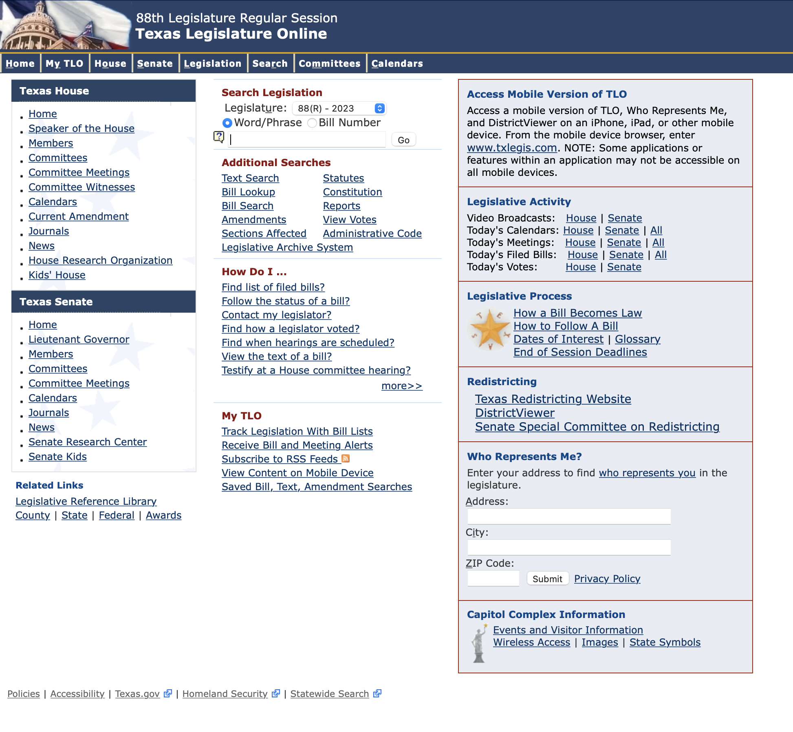
Committee Discussions
TLO: https://capitol.texas.gov/Home.aspx
Join us on Social Media #DFWRHCA @DFWRHCA

Slide 7
Committee Discussions
Open Discussion
Market Conditions
Creating of Subcommittees
Weekly Friday meetings to review bills
Fridays 9:00 am – 9:30 am
Safety
Workforce Development and Labor
Economic Development and Inclusion
Other____
Join us on Social Media #DFWRHCA @DFWRHCA

Slide 8
Registration: http://events.r20.constantcontact.com/register/event?oeidk=a07ejmz97itb791f0ae&llr=ymfrebdab
Construction Worker of the Year Nominations: https://rhca.awardsplatform.com
Join us on Social Media #DFWRHCA @DFWRHCA

Slide 9
Registration: https://form.jotform.com/230454822103142
Worker of the Year Nominations: https://form.jotform.com/230236984656061
Sponsorship Opportunities: https://form.jotform.com/230305221953042
Join us on Social Media #DFWRHCA @DFWRHCA

Slide 10
https://form.jotform.com/223546066396160
Join us on Social Media #DFWRHCA @DFWRHCA

Slide 11
https://form.jotform.com/222965555456164
Join us on Social Media #DFWRHCA @DFWRHCA

Slide 12
https://form.jotform.com/230085618271151
Join us on Social Media #DFWRHCA @DFWRHCA

Slide 13
RHCA | Subcommittee
Help with inviting monthly guest speakers
Example:
The invitation details are listed below:
Date: Wednesday, February 14, 2022
Time Duration: 20 minutes (if you need more, please let me know)
Time Range: Any 20 minutes between 8:45am to 10:00am CST
Via online Video: Zoom Video Conference
Committee: RHCA Legislative and Public Policy: Audience – Contractors/Professional Services/Public Agency Employees/Small Business Owners
Topic: How the 2020 Census Data is used for Redistricting and the impact it has to you personally and your business
Presentation: PowerPoint Due by Monday, February 14
Other Items Needed: (1) Headshot in JPEG (2) Title (3) Bio
Join us on Social Media #DFWRHCA @DFWRHCA

Slide 14
Q & A
Join us on Social Media #DFWRHCA @DFWRHCA

Slide 15
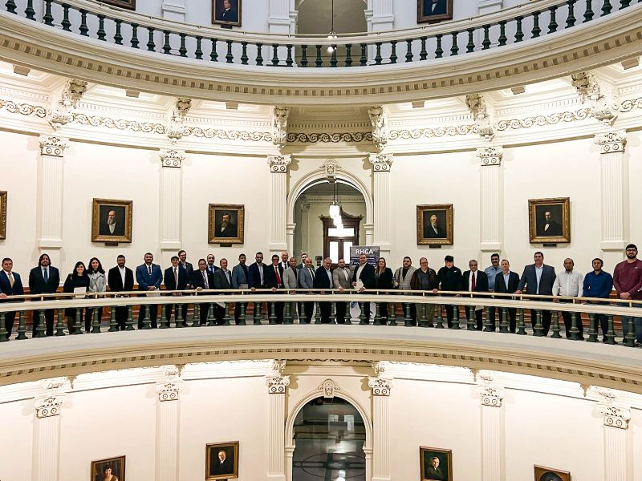
Legislative
Number of Bills being tracked by RHCA - 183 Bills
Identified Priority Bill(s)
HB 5140
Relating to a prohibition against the consideration of race or ethnicity as a factor in governmental employment or contracting, in other governmental functions, and in higher education admissions.
Why is it important to the RHCA? State Contracts with Minority goals would be prohibited.
Recommended Stance: Not Support
Join us on Social Media #DFWRHCA @DFWRHCA

Slide 16
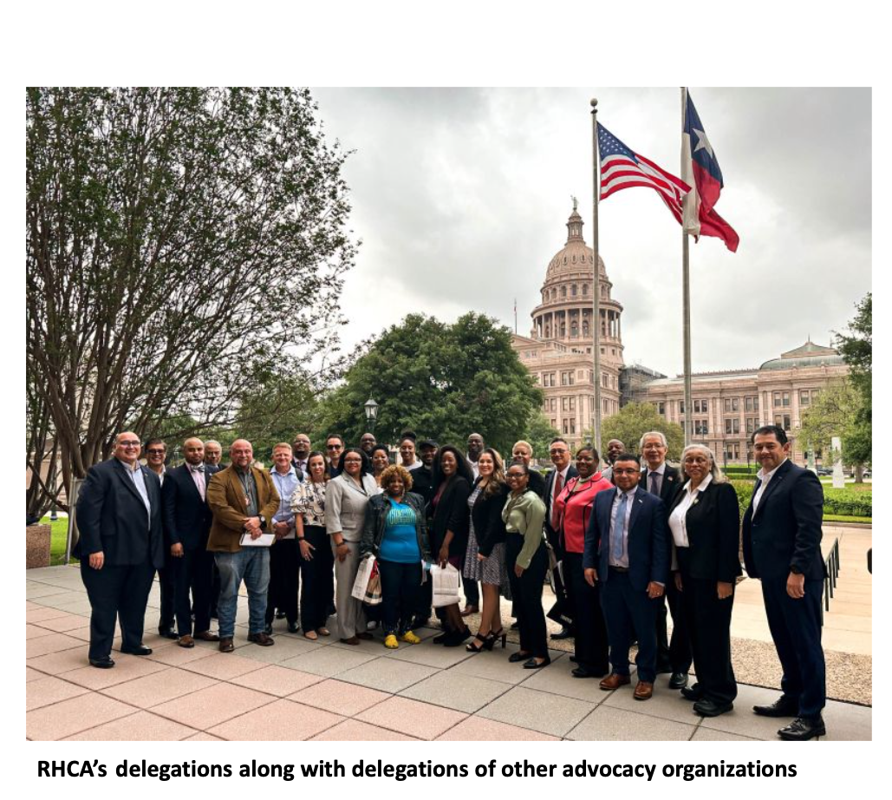
Join us on Social Media #DFWRHCA @DFWRHCA

Slide 17
Join us on Social Media #DFWRHCA @DFWRHCA

Slide 18
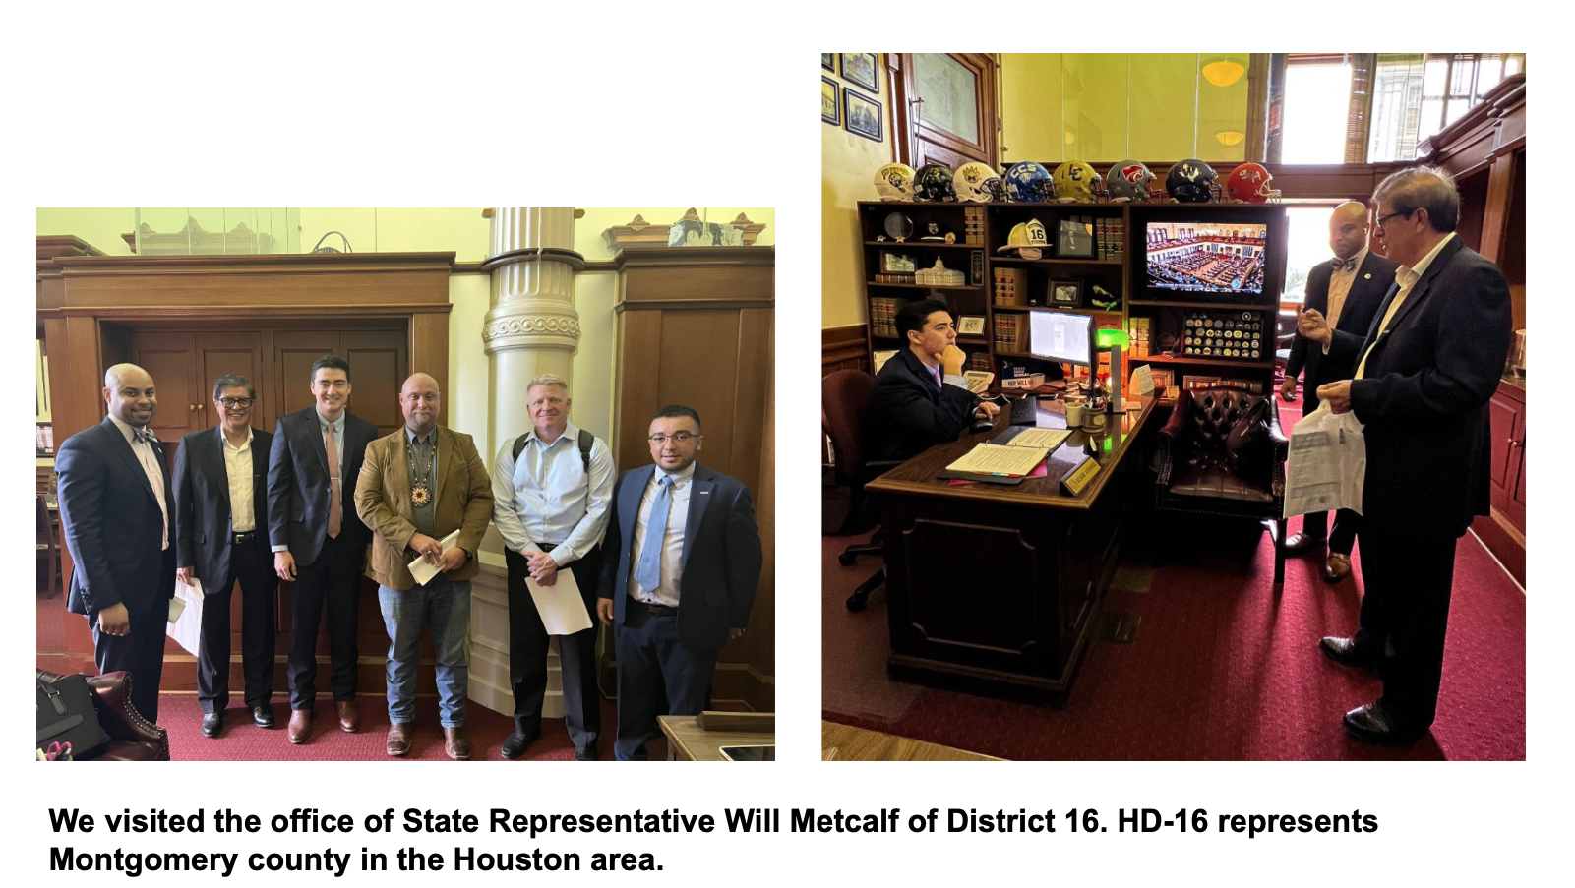
RHCA Visit to Capitol to kill HB 5140
Join us on Social Media #DFWRHCA @DFWRHCA

Slide 19
Join us on Social Media #DFWRHCA @DFWRHCA

Slide 20
Join us on Social Media #DFWRHCA @DFWRHCA

Slide 21
Join us on Social Media #DFWRHCA @DFWRHCA

Slide 22
Join us on Social Media #DFWRHCA @DFWRHCA

Slide 23
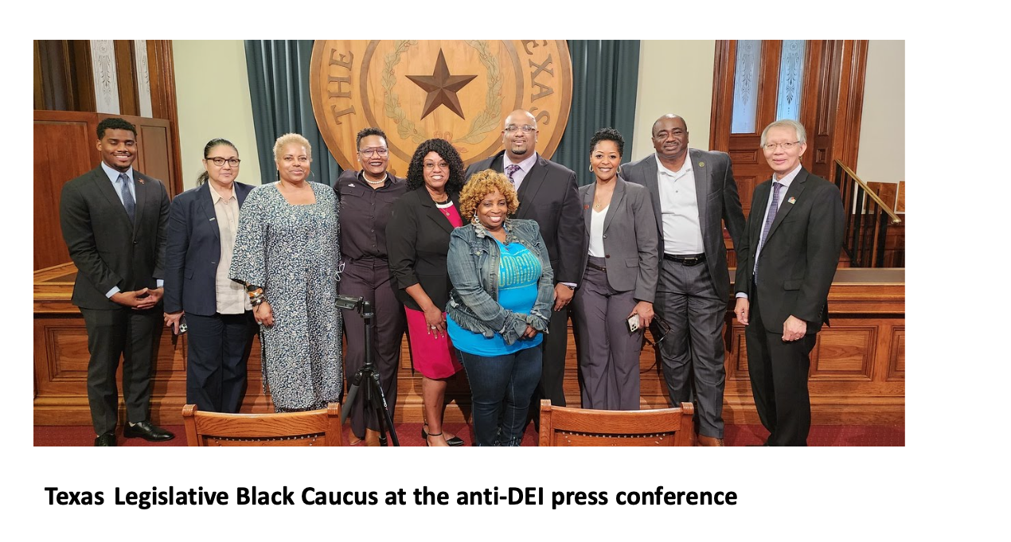
Join us on Social Media #DFWRHCA @DFWRHCA

Slide 24
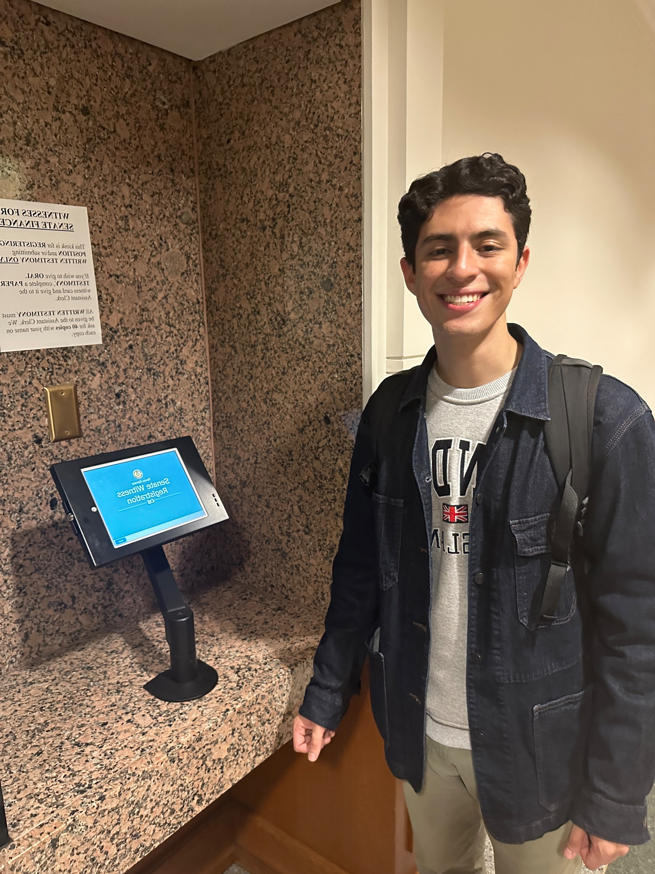
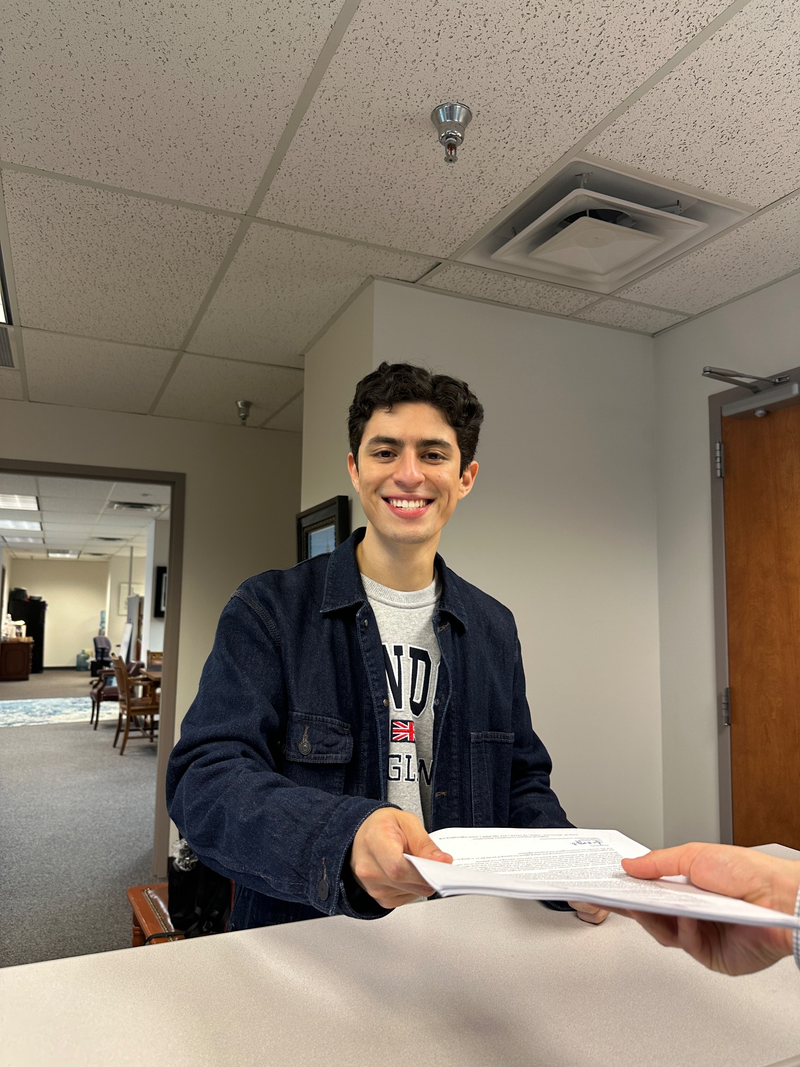
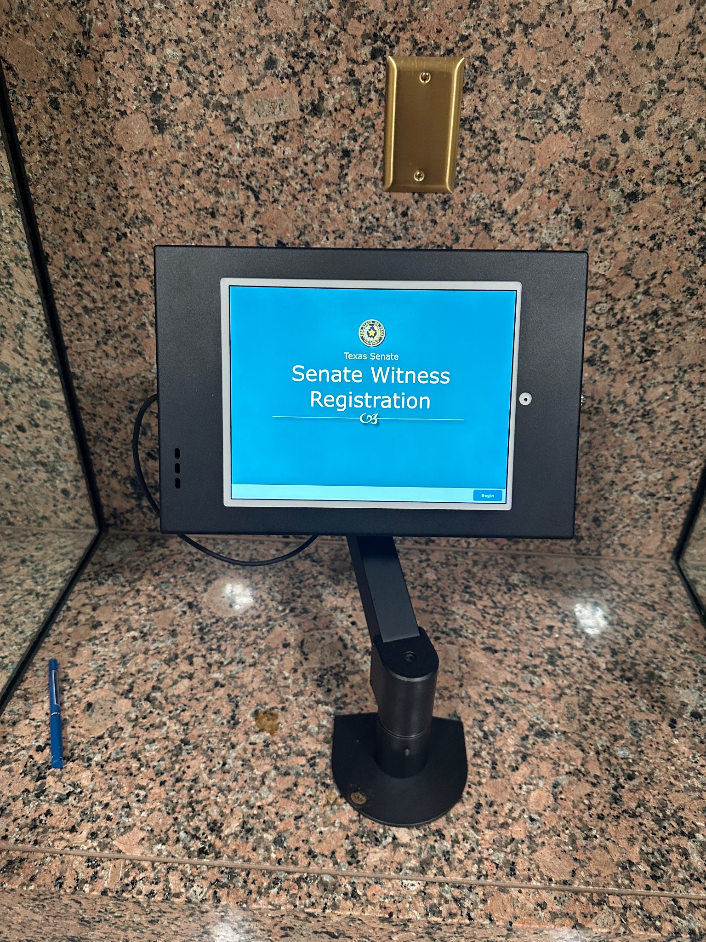
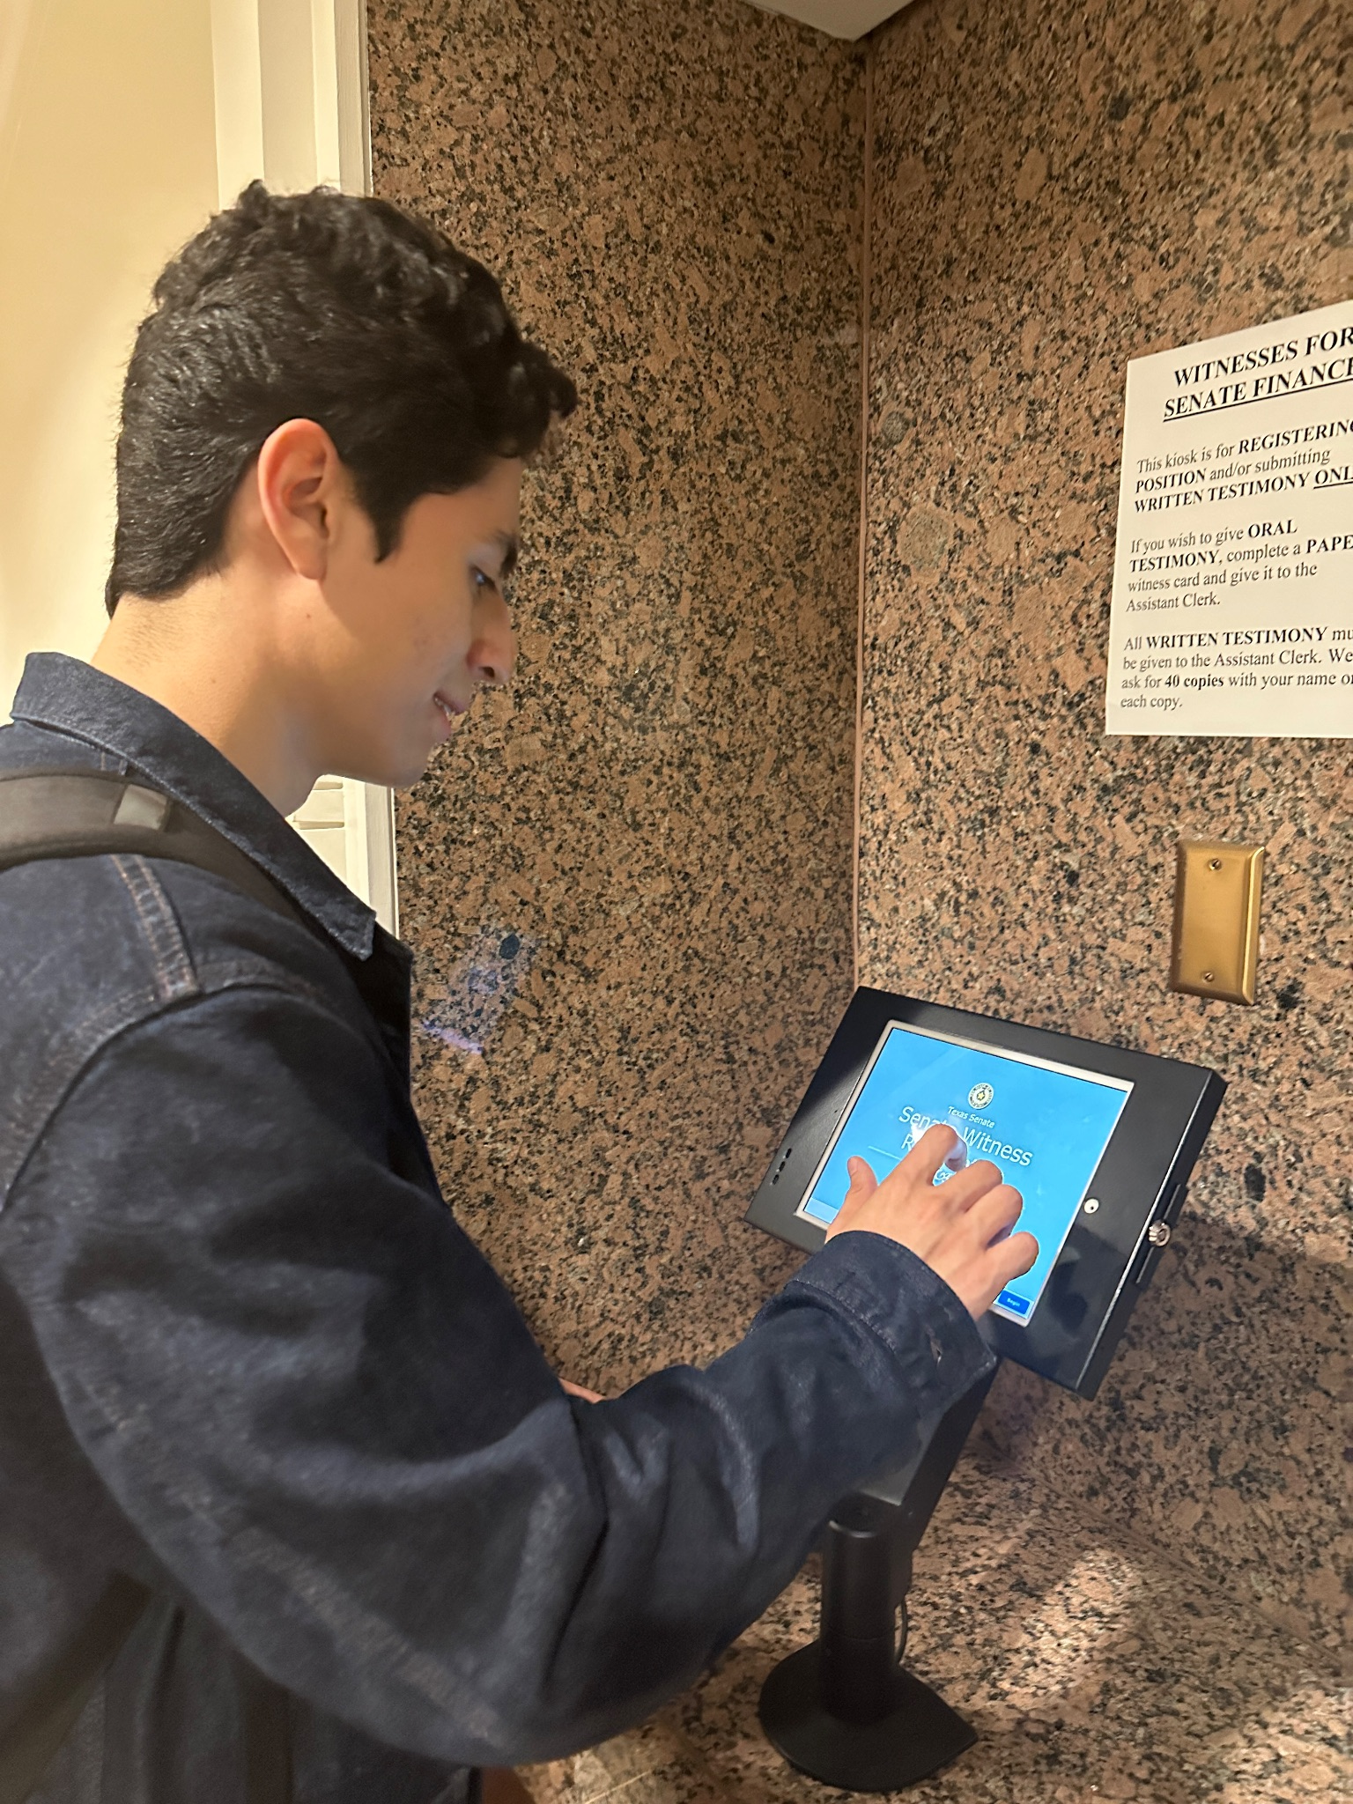
Testifying against SB 17
On Thursday, April 6th, Fernando dropped off copies of RHCA’s written testimony against SB 17.
Senate Witness Registration was completed in the kiosk tablets outside of the designated committee hearing room (E1.028).
Subsequently, the written testimonies were dropped off at the Senate Committee on Education’s Office.
Join us on Social Media #DFWRHCA @DFWRHCA

Slide 25
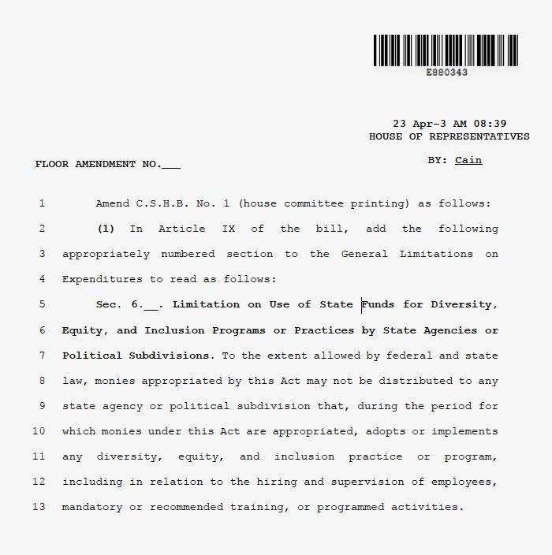
Budget Night for the 88th Legislature
On the night of Thursday, April 6th, 2023, the Texas House of Representatives carried out their hearing of HB 1, also known as “Budget Night”.
HB 1 passed on a vote of 136-10.
Lawmakers debated for more than 12 hours.
One important outcome of budget night is that Texas lawmakers kept their anti-DEI proposal.
Join us on Social Media #DFWRHCA @DFWRHCA

Slide 26
Bills Referred to Committee Hearings This Week
HB 4389 (Cole, Sheryl)
Committee Hearing Scheduled for Monday, April 17th
Caption: Relating to the funding mechanism for the regulation of workers' compensation and workers' compensation insurance.
HJR 27 (Craddick, Tom)
Committee Hearing Scheduled for Monday, April 17th
Caption: Proposing a constitutional amendment providing for the creation of and use of money in the Grow Texas fund and allocating certain general revenues to that fund, the economic stabilization fund, and the state highway fund.
HB 1392 (Craddick, Tom)
Committee Hearing Scheduled for Monday, April 17th
Caption:
HB 1963 (Leach, Jeff)
Committee Hearing Scheduled for Monday, April 17th
Caption: Relating to construction contract trust funds.
HB 2657 (Leach, Jeff)
Committee Hearing Scheduled for Monday, April 17th
Caption: Relating to voidable provisions in certain construction contracts
HB 2928 (Turner, Chris)
Committee Hearing Scheduled for Monday, April 17th
Caption: Relating to the payment or application of funds under construction contracts.
Join us on Social Media #DFWRHCA @DFWRHCA

