Slide 1
Legislative and Public Policy Committee Meeting
RHCA . . . the leader in Diversity Inclusion
Networking and building business relationships and opportunities
May 12, 2023
Disclaimer: This webinar is not intended for press purposes. If you are part the press, please disconnect.
Join us on Social Media #DFWRHCA @DFWRHCA

Slide 2
Housekeeping Rules
Keep yourself muted throughout the meeting
Please make sure to stay for the whole meeting
Presentation will be emailed
Q&A will be after each presentation
Ask questions in the chat
Please make sure to keep your camera on, at all times
If you get logged out, please re-login using the same link
Join us on Social Media #DFWRHCA @DFWRHCA

Slide 3
Welcome
Join us on Social Media #DFWRHCA @DFWRHCA

Slide 4
Committee Discussions
Join us on Social Media #DFWRHCA @DFWRHCA

Slide 5
https://myemail.constantcontact.com/RHCA-Legislative-Updates.html?soid=1102771164568&aid=dDCpkjhBJDU
Join us on Social Media #DFWRHCA @DFWRHCA

Slide 6
Committee Discussions
Statewide Initiative
Project Opportunities
Legislative
2023 – 2024 Texas 88th Legislative Strategic Agenda A Public Policy Platform
Tracking Bills
88th Legislative Bill Tracker – Comprehensive – Excel
Platform as guide
Testimony
Develop letter template
Hearings
Legislative Hearings & Subcommittee Roles
2023 – 2024 Advocacy Platform
Join us on Social Media #DFWRHCA @DFWRHCA

Slide 7
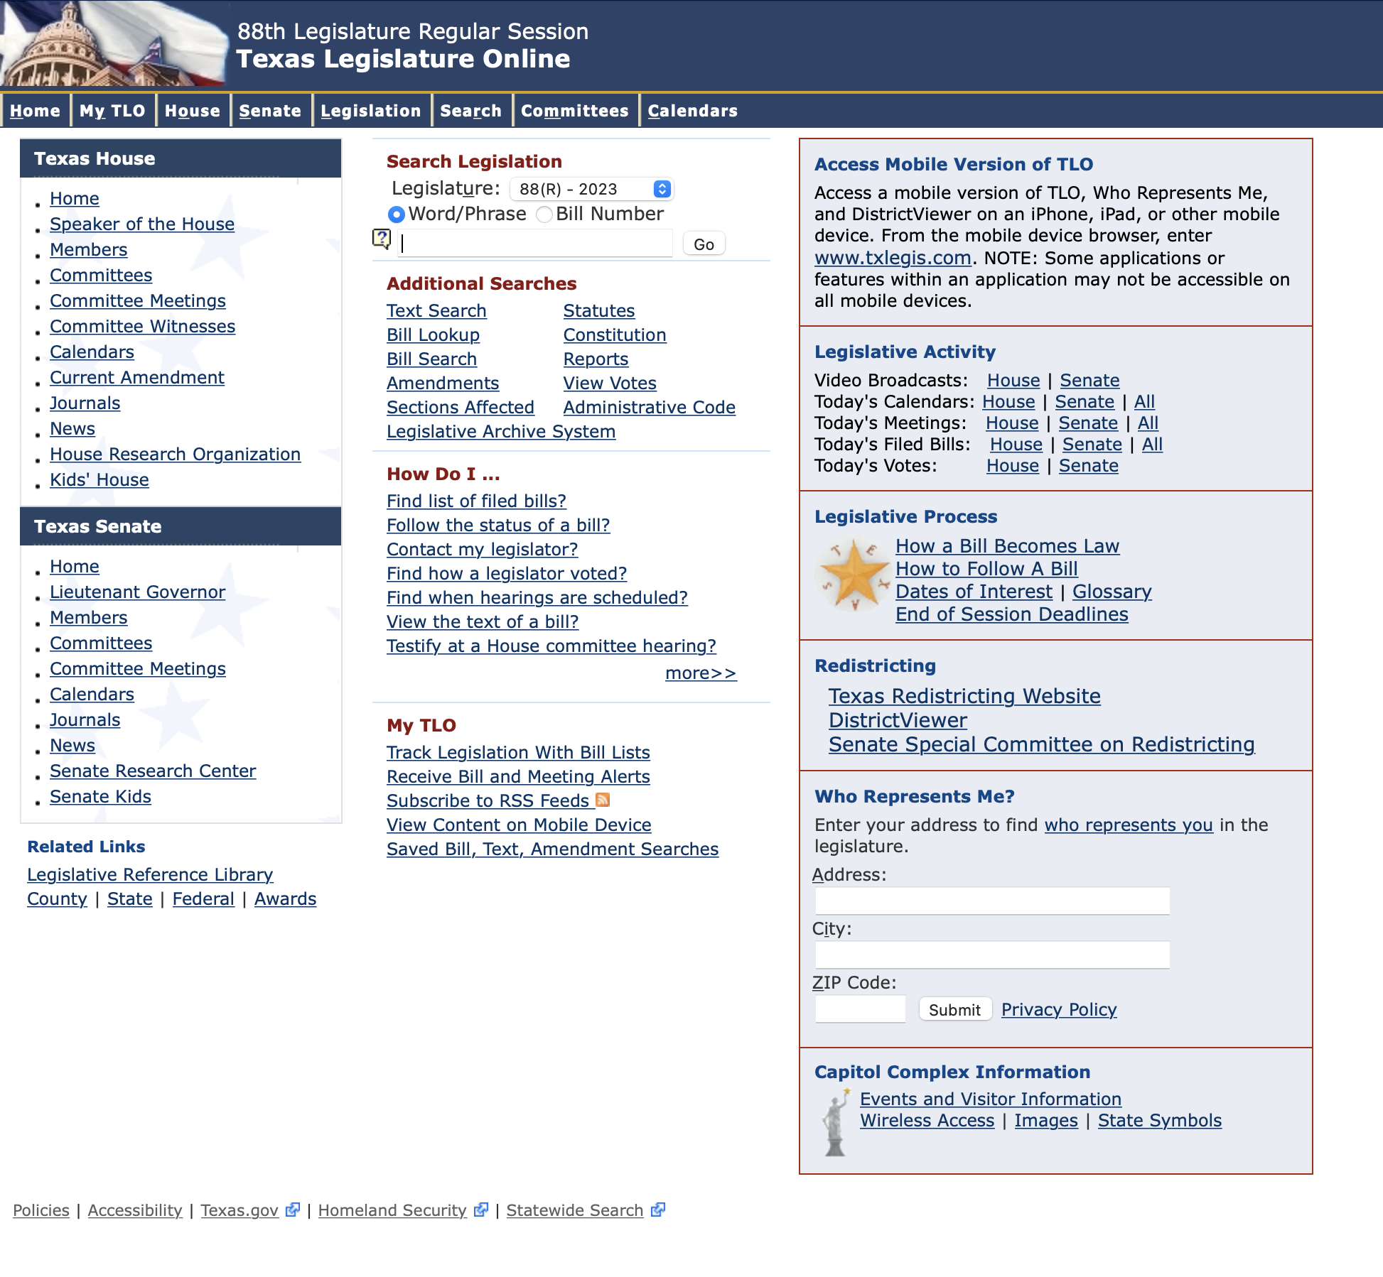
Committee Discussions
TLO: https://capitol.texas.gov/Home.aspx
Join us on Social Media #DFWRHCA @DFWRHCA

Slide 8
Committee Discussions
Open Discussion
Market Conditions
Creating of Subcommittees
Weekly Friday meetings to review bills
Fridays 9:00 am – 9:30 am
Safety
Workforce Development and Labor
Economic Development and Inclusion
Other____
Join us on Social Media #DFWRHCA @DFWRHCA

Slide 9
https://form.jotform.com/223546066396160
Join us on Social Media #DFWRHCA @DFWRHCA

Slide 10
https://form.jotform.com/222965555456164
Join us on Social Media #DFWRHCA @DFWRHCA

Slide 11
https://form.jotform.com/230085047889162
Join us on Social Media #DFWRHCA @DFWRHCA

Slide 12
https://form.jotform.com/230085618271151
Join us on Social Media #DFWRHCA @DFWRHCA

Slide 13
RHCA | Subcommittee
Help with inviting monthly guest speakers
Example:
The invitation details are listed below:
Date: Wednesday, February 14, 2022
Time Duration: 20 minutes (if you need more, please let me know)
Time Range: Any 20 minutes between 8:45am to 10:00am CST
Via online Video: Zoom Video Conference
Committee: RHCA Legislative and Public Policy: Audience – Contractors/Professional Services/Public Agency Employees/Small Business Owners
Topic: How the 2020 Census Data is used for Redistricting and the impact it has to you personally and your business
Presentation: PowerPoint Due by Monday, February 14
Other Items Needed: (1) Headshot in JPEG (2) Title (3) Bio
Join us on Social Media #DFWRHCA @DFWRHCA

Slide 14
Q & A
Join us on Social Media #DFWRHCA @DFWRHCA

Slide 15
Bills Referred to Committee Hearings This Week (Monday-Tuesday)
SB 17 (Creighton, Brandon)
RHCA Position NOT SUPPORT ON RECORD
Committee: House Higher Education Committee Hearing Scheduled for Monday, May 8th at 8:00 am (E2.010)
Caption: Relating to public higher education reform.
Link:
SB 18 (Creighton, Brandon)
RHCA Position NOT SUPPORT ON RECORD
Committee: House Higher Education Committee Hearing Scheduled for Monday, May 8th at 8:00 am (E2.010)
Caption: Relating to tenure and employment status at public institutions of higher education in this state.
HB 2022 (Leach, Jeff)
RHCA Position NO RHCA POSITION
Committee: Senate Business & Commerce Committee Hearing Scheduled for Tuesday, May 9th at 8:30 am (E1.012)
Caption: Relating to residential construction liability
HB 2453 (Guillen, Ryan)
RHCA Position SUPPORT
Committee: Senate Business & Commerce Committee Hearing Scheduled for Tuesday, May 9th at 8:30 am (E1.012)
Caption: Relating to the issuance of digital licenses by a licensing agency.
Join us on Social Media #DFWRHCA @DFWRHCA

Slide 16
Bills Referred to Committee Hearings This Week (Tuesday-Wednesday-Thursday)
SCR 26 (Hughes, Bryan)
RHCA Position NOT SUPPORT ON RECORD
Committee: House International Relations & Economic Development Committee Hearing Scheduled for Wednesday, May 10th at 9:00 am (E1.026)
Caption: Urging Congress of the United States to amend federal law to allow states to provide for the consolidation of federally funded workforce development services.
HB 2334 (Burns, DeWayne)
RHCA Position MONITOR
Committee: Senate Business & Commerce Committee Hearing Scheduled for Thursday, May 11th at 8:30 am (E1.012)
Caption: Relating to an exemption from the plumbing licensing law for plumbing work performed on certain private property.
HB 2518 (Bell, Keith)
RHCA Position SUPPORT
Committee: Senate Business & Commerce Committee Hearing Scheduled for Tuesday, May 9th at 8:30 am (E1.012)
Caption: Relating to public work contracts, including contracts on public property leased to a nongovernmental entity.
SB 1399 (Schwertner, Charles)
RHCA Position MONITOR
Committee: House Environmental Regulation Committee Hearing Scheduled for Wednesday, May 10th at 9:00 am (E2.010)
Caption: Relating to the renewal and review of certain air quality permits.

Slide 17
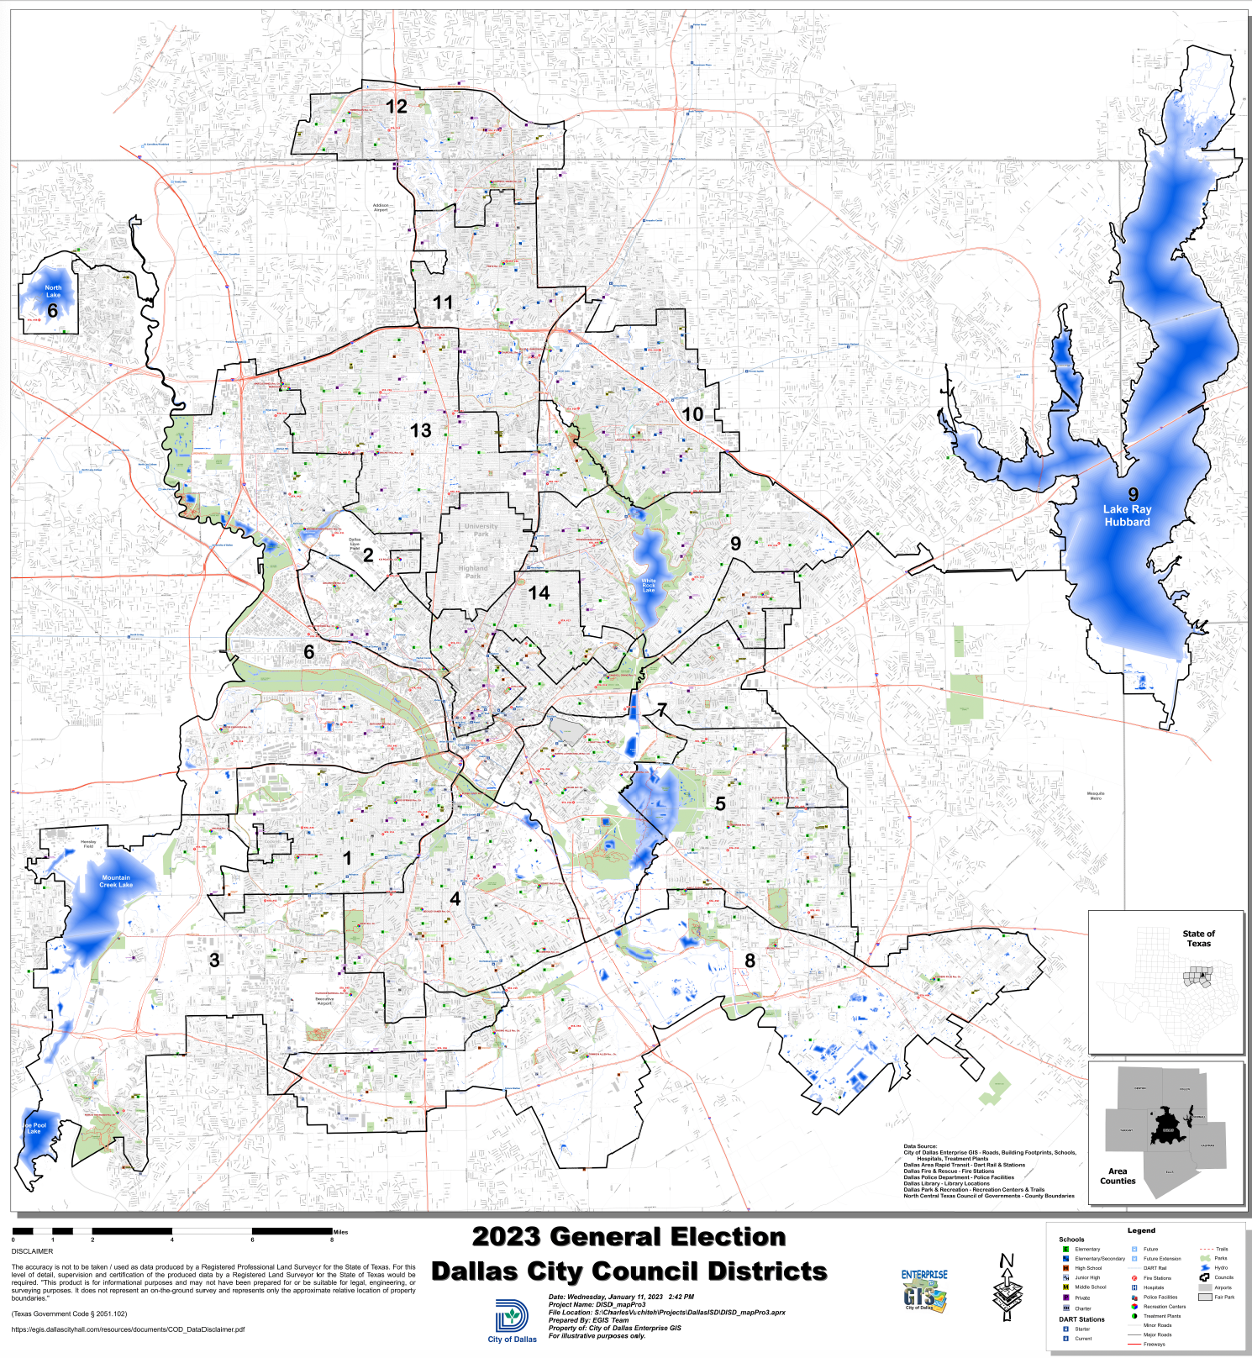
Dallas City Council Elections
District 1 - Chad West (i)
District 2 - Jesse Moreno (i)
District 3 - Runoff Election - Zarin Gracey (46%), Joe Tave (25%)
District 4 - Carolyn King Arnold (i)
District 5 - Jaime Resendez (i)
District 6 - Omar Narvaez (i)
District 7 - Adam Bazaldua (i)
District 8 - Tennell Atkins (i)
District 9 - Paula Blackmon (i)
District 10 - Kathy Stewart
District 11 - Jaynie Schultz (i)
District 12 - Cara Mendelsohn (i)
District 13 - Gay Donnell Willis (i)
District 14 - Paul Ridley (i)
City Mayor - Eric Johnson (93%) (i) *(i) = incumbent
*Runoff Elections will be held on June 10th, 2023
Join us on Social Media #DFWRHCA @DFWRHCA

Slide 18
Dallas City Council Elections
Dallas City Council
The Dallas City Council serves as the legislative body in the City of Dallas. It consists of 14 members. City council members are chosen by plurality elections in each of fourteen districts. The city operates under a council-manager system of local governance.
Term Lengths
Term Lengths for City Councilmembers is 2 years. There is a limit for serving four consecutive terms, 4 x 2 = 8 years.
Term Lengths for Mayors is 4 years. There is a limit of serving 2 consecutive terms for mayors, 2 x 4 = 8 years.
Compensation
City Councilmembers are compensated $60,000 each year of service. Meanwhile, City Mayors are compensated up to $80,000 each year of service. (Source; DMagazine)
Join us on Social Media #DFWRHCA @DFWRHCA

