Slide 1
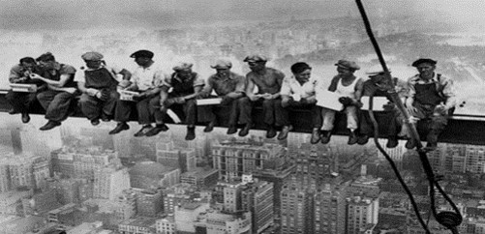
Fall Protection Training OSHA - Susan Harwood Training Grant

Slide 2
To register for today’s class, please scan the QR Code

Slide 3
Welcome in-person
Please sign the attendance sheet - QR code
Take one handout (Folder with QR code)
There will be a group activity
Pre & Post-Test & Evaluation
LOCATION
Emergency Exits
Emergency Stairs
Location of restrooms
Location of water fountains (If applicable)

Slide 4
House keeping rules
Please keep mask on at all times
No talking during class
No cell phone usage during class
Be sure to fill out all required forms (Electronic)

Slide 5
Disclaimer
This material was produced under grant number SH-000036-SH3 from the Occupational Safety and Health Administration, U.S. Department of Labor. It does not necessarily reflect the views or policies of the U. S. Department of Labor, nor does mention of trade names, commercial products, or organizations imply endorsement by the U. S. Government.

Slide 6
Susan Harwood Grant
The Fall Protection course is offered for free to the construction community through the Susan Harwood Training Grant from the Occupational Safety and Health Administration (OSHA) under the U.S. Department of Labor (DOL)
The Fall Protection Course covers the area that causes the majority of deaths and injuries in construction. “Falls”
This material was produced under grant number SH-000036-SH3 from the Occupational Safety and Health Administration, U.S. Department of Labor. It does not necessarily reflect the views or policies of the U.S. Department of Labor, nor does mention of trade names, commercial products, or organizations implied endorsement by the U.S. Government.

Slide 7
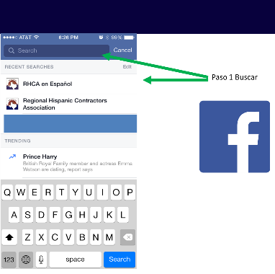
Follow us on social media
Step 1
Step 2 @RHCAenEspanol - Spanish
Search
Step 2 @DFWRHCA - English
@DFWRHCA
Regional Hispanic Contractors Association (RHCA)

Slide 8
Workers’ Rights

Slide 9
Fall Prevention Fact Sheet

Slide 10
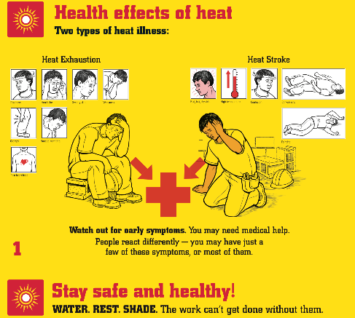
Health effects of heat

Slide 11
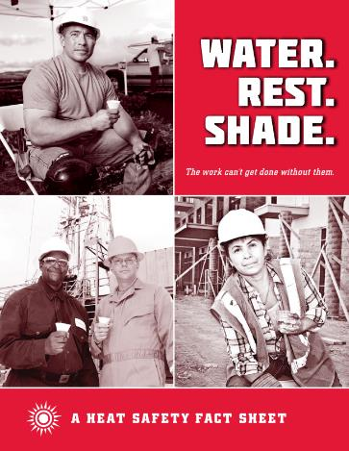
A Heat Safety Fact Sheet

Slide 12
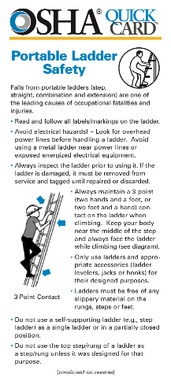
OSHA Portable Ladder Safety

Slide 13
QR Code to download Training material

Slide 14
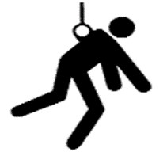
Agenda
Welcome
Introduction to OSHA
Worker’s rights
Introduction to Fall Protection
Recognition of Fall Hazards
Basic Fall Prevention Principles
Basic Fall Protection Principles
Brief Review of Applicable Standards

Slide 15
Agenda
Controlling the Hazard
Hierarchy of Controls
Restrain
Components
Fall Clearance
Inspections
Rescue
Certificates

Slide 16
FALL PROTECTION PRE-TEST
In general, fall protection must be provided to construction workers who are working on surfaces with unprotected sides and edges which are ____________ above the lower level.
(a) 3 ft.
(b) 4 ft.
(c) 6 ft.
(d) 8ft.

Slide 17
2. What are the ways an employer can protect workers from falls on site?
(a) Guardrails, safety net systems and safety belts
(b) Guardrails and safety net systems
(c) Guardrails, safety net systems and personal fall arrest systems
(d) Top rail, middle rail, toe board

Slide 18
3. A personal fall arrest system consists of:
(a) An anchorage and a body belt
(b) An anchorage, lanyard and connectors and a body belt
(c) An anchorage, lanyard and connectors and a full body harness
(d) A full body harness and a lanyard

Slide 19
4. After a fall accident occurs, the first step is to take is:
(a) Report orally to OSHA
(b) Fill the 300A form
(c) Videotape the scene
(d) Implement the emergency procedure that best fits the situation

Slide 20
5. If you are asked to perform a job that you feel is unsafe, you should do it anyways because you might get fired otherwise.
True
(b) False

Slide 21
6. Employee may file a complaint with OSHA under Section 11(c) if your employer retaliates against you by taking unfavorable personnel action because you engaged in protected activity relating to workplace safety and health. OSHA requires that complaints must be filed within ____ after the alleged retaliation.
(a) 3 days
(b) 7 days
(c) 30 days
(d) 90 days

Slide 22
7. One who, by possession of a recognized degree, certificate or professional standing or by extensive knowledge, training and experience, has successfully demonstrated his ability to resolve problems relating to the subject matter, the work or the project is called a ________
(a) Authorized Person
(b) Competent Person
(c) Qualified Person
(d) Smart Person

Slide 23
Introduction to osha
Overview of anti-retaliation provisions, employee rights, employer responsibilities, whistleblower laws, and OSHA’s complaint investigation procedures

Slide 24
Why is OSHA Important to You?
OSHA began because, until 1970, there were no national laws for safety and health hazards.
On average, 12 workers die every day from job injuries
Worker deaths in America are down–on average, from about 38 worker deaths a day in 1970 to 12 a day in 2013.
WORKER FATALITIES
4,836 workers were killed on the job in 2015
Falls — 364 out of 937 total deaths in construction in CY 2015 (38.8%)

Slide 25
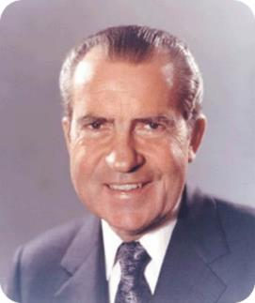
History of OSHA
OSHA stands for the Occupational Safety and Health Administration, an agency of the U.S. Department of Labor
OSHA’s responsibility is worker safety and health protection
On December 29, 1970, President Nixon signed the OSH Act
This Act created OSHA, the agency, which formally came into being on April 28, 1971

Slide 26
OSHA’s Mission
To save lives
To prevent injuries
To protect America’s workers

Slide 27
OSHA’s Inspection Priorities

Slide 28
Rights as a Whistleblower
Employee may file a complain with OSHA under Section 11(c) if your employer retaliates against you by taking unfavorable personnel action because you engaged in protected activity relating to workplace safety and health.
OSHA requires that complaints must be filed within 30 days after the alleged retaliation.

Slide 29
Rights as a Whistleblower
Your employer may be found to have retaliated against you if your protected activity was a contributing or motivating factor in its decision to take unfavorable personnel action against you. Such actions may include:
Firing or laying off
Blacklisting
Denying overtime or promotion
Disciplining
Denying benefits
Failing to hire or rehire
Intimidation
Reassignment affecting promotion prospects
Reducing pay or hour

Slide 30
Questions about OSHA?

Slide 31
Introduction to Fall Protection

Slide 32
Objectives
Recognize, avoid and prevent fall hazards in construction
Identify major fall hazards
Describe types of fall hazards
Protect him/herself from fall hazards
Recognize employer requirements to protect workers from fall hazards

Slide 33
Falls in Construction
FALLS ARE THE LEADING CAUSE OF DEATH IN CONSTRUCTION.
In 2015, there were 350 fatal falls to a lower level out of 937 construction fatalities (BLS data). These deaths are preventable.

Slide 34
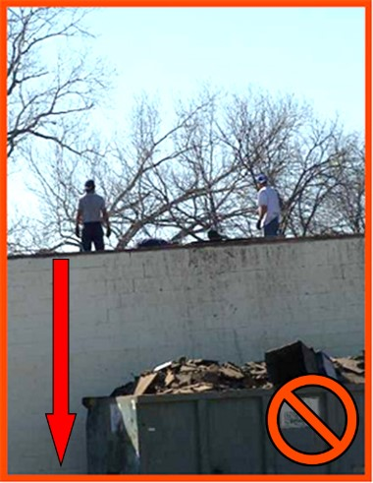
Building Structures
Work conditions 6’ or more above lower level require the use of fall protection:
Unprotected sides, edges
Leading edges
Excavations
Walking/working surfaces

Slide 35
OSHA Regulations on Fall Protection
General Industry:
Fall protection required when working at 4 feet above lower level
Construction Industry:
Fall protection required when working at 6 feet above lower level
Employer’s operations will completely or mostly fall under one of the sectors listed and will follow their regulations.
Notes:
Discuss who OSHA is and its purpose.
OSHA's Mission:
“With the Occupational Safety and Health Act of 1970, Congress created the Occupational Safety and Health Administration (OSHA)* to assure safe and healthful working conditions for working men and women by setting and enforcing standards and by providing training, outreach, education and assistance.”
Organization
“OSHA is part of the United States Department of Labor. The administrator for OSHA is the Assistant Secretary of Labor for Occupational Safety and Health. OSHA's administrator answers to the Secretary of Labor, who is a member of the cabinet of the President of the United States.”
Explain that most workers will be covered under one of two sets of regulations, although there are exceptions (with work at marine terminals, shipyards, and in mines being one of the major ones).
OSHA “Parts” (1910 & 1926) can be thought of as “books,” and “Subparts” can be thought of as “chapters” within those books. Each book has a dedicated “chapter” (or, in the case of GI, two) dedicated to issues related to FP.
Explain that they will only fall under one set of regulations and need to follow what is laid out therein

Slide 36
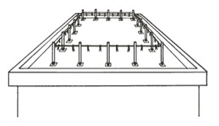
Warning Lines – 1926 Roofing
4-sided set of lines in-place to warn workers of edge hazard
NOT a guardrail
Distances from edge:
6’ - General
10’ – “Mechanical Equipment”
Permit work inside w/ no PFAS
Points of access, materials handling areas, storage areas, and hoisting areas connected by access path formed by two warning lines
Rope / Wire / Chain Gate or “Other Barricade”
Offset Access
Notes:
One of the first important points to be made on warning lines is they are what the name implies: lines that are suspended around the work area that will warn the unsuspecting worker as they back up that they are approaching an exposed edge; if a worker falls into them, they will fall over, but they are of sufficient distance from the edge to prevent a fall, so they are effective in a different way from guardrails.
The rules on distance are as follows:
In roofing activities, they need to be at least:
6’ from the edge when mechanical equipment is not being used;
10’ from the edge in the direction of travel when mechanical equipment is being used.
“Mechanical equipment” is “all human propelled wheeled equipment used for roofing work, except wheelbarrows and mopcarts.”
Unsupervised workers will often put lines up and move them closer to the edge than these specified distances, making an easy violation to spot, when they are doing roofing work that is going to take them towards the parapets.
This will be the case if they are laying felt paper or shingling, for example, on an entire roof.
Thus, a plan needs to be in-place (i.e. use of a PFPS or Safety Monitor) needs to be prepared ahead-of-time and spelled out for when this is to happen.
The beauty of these systems is that they permit work inside the lines with no need for guardrails or a PFPS, thus making mobility and setup time much faster.
OSHA permits two options for access into and egress out of a set of warning Lines: (a) barricade and (b) offset lines.
An offset access is generally the better way to go since it takes human error (i.e. not putting a chain gate back up once passing through it) out of the equation.
Ask why OSHA would want lines to be marked every 6’. (Visibility for Workers)
Note that the specified line heights are different than those that are laid-out for guardrail systems.
As is discussed in the manual, and will sometimes be asked in class, employers may want to know if painted lines around the perimeter of the roof at the prescribed distances will work. OSHA, through LOI, however, has said that they will not. In cold climates where it will snow, these lines will do not good when covered. And at night in all climates, the line will become obscured by darkness.
The “tip force” noted on this page is the force that one of the posts needs to be able to withstand without falling over.
This resistance is mainly so that posts aren’t constantly falling over when the wind blows on them.
Sites could use store-bought systems or sink posts in five-gallon buckets filled with concrete.
In regards to line strength, OSHA clearly sets out a minimum requirement. It is not difficult at all to find a site where they are attempting to demonstrate use of warning lines where you will see yellow caution tape (which doesn’t have a 500 lbs. breaking strength) right at the edge of the rooftop, thus violating two rules.
With the prevention of slack buildup clause, the idea is part of the system sags to ground level and someone can easily step over it with or without noticing, the system has lost its ability to protect.

Slide 37
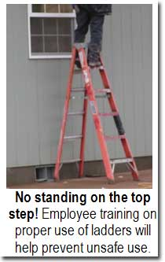
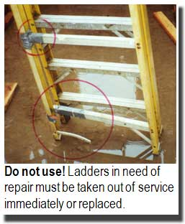
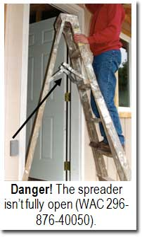
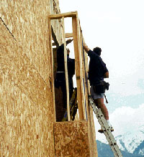
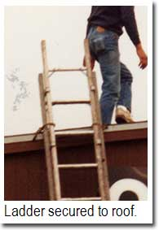
Misuse of Portable Ladders
This one seems properly inclined and secured

Slide 38
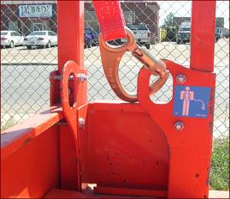
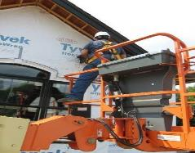
Aerial Lift Fall Protection
Is fall protection required?
Where is the correct place to attach?
What about outside the basket?
Basket guardrails?
General Prohibitions:
Moving large distances w/ the basket elevated
Standing on the basket guardrails
Notes:
Ask the students whether or not fall protection is required in one of these lists, per the first bullet point. The answer is “yes,” to which you should ask “why.”
The answer to the second question is that these lifts are notorious for being able to bounce a worker out of the basket, much like a catapult, if they are driving them too fast and hit an obstruction with the boom lowered or if they are at heights and, even more slowly, hit an object on the ground, causing the extended boom to flex and jettison the worker.
There are a number of videos on YouTube that can be found showing exactly this occurring.
This instructor once took a class at JLG’s Train-the-Trainer school with its lead instructor who commented that he once saw a worker fatality case where the unconnected victim was thrown higher than a utility pole.
The correct place to attach in an aerial lift is to the manufacturer-specified point(s) in the basket, as illustrated in the photo at the top of the slide. Generally these will be on a guardrail upright post somewhere inside the basket or on the floor and will have a label indicating their purpose toward this end.
As an answer to the other questions below the correct place to attach, outside the basket is generally prohibited by OSHA unless the worker is transferring out of the basket practicing 100% connection; in this case connection outside the basket will only be temporary while transition takes place.
A February 2, 2004 LOI to a Mr. Michael P. Kurtgis, states OSHA’s concerns with a worker who is attached outside the basket to an adjacent structure:
“Section 1926.453(b)(2)(v) states that fall protection is required for persons working from an aerial lift, and that the fall protection system must be attached to the boom or basket of an aerial lift. The purpose of this requirement is to protect employees from being bounced out of the aerial lift or placing themselves in a position from which they could be exposed to a fall by leaning over the basket. Further, §1926.453(b)(2)(iii) prohibits tying off fall protection to an adjacent pole, equipment or structure. This prohibition addresses, among others, the hazard of such an adjacent pole / structure failing and pulling the attached worker from a bucket. This may occur where, for example, a pole has rotted and fails while work is done to equipment attached to it, or where a traffic accident occurs in which a vehicle strikes the pole. These provisions reflect a concern that the type of "adjacent" structures typically associated with work done from aerial lifts are unreliable with respect to their condition (and so their ability to withstand loads imposed on them while work is being done) and vulnerability to traffic accidents.
…
However, limited situations may exist where an adjacent structure poses no reasonably foreseeable risk of failure. For example, such an instance might arise where the adjacent structure is a completed building or a completed (i.e., fully bolted-up) skeletal steel structure. In those instances, OSHA would consider the violation of §1926.453(b)(2)(iii) to be de minimis² and no citation would be issued.”
Attaching to aerial lift guardrails is like attaching to any other guardrails: impermissible. They were not designed for this purpose and shall not be used for it, especially when it is considered that attachment points will have been provided.
Students may have questions on the strength of anchorage points in aerial lifts.
In general, the statement can be made that if the vehicle meets ANSI / SIA A92.2 or A92.5 requirements it will be able to withstand a minimum force of 3,600 pounds (which will work for fall arrest).
Scissor lift anchorages, to be discussed shortly, have no such requirement and often may just be rated for restraint loads. In the case that the information is not provided, the company shall contact the manufacturer to determine what type of anchorage has been provided.
In regards to the connector, each of the options have benefits and limitations. A document called “Statement of Best Practices of Personal Fall Protection Systems for Aerial Work Platform Equipment” gives some guidance as to each of these options:
Restraint Lanyard
Per the above article, “In the case of a boom lift, the forces from the “catapult effect” would not cause the occupant to be thrown from the platform but rather remain within the confines of the work platform.”
A limitation with restraint lanyards is that they don’t allow mobility. When it is considered that it is fall arrest as soon as the worker’s CoG could go over the guardrails in any possible orientation, it isn’t hard to see that a really short lanyard will often be needed. The problem, however, becomes that if the worker is connected to such a short “leash,” they become tempted to disconnect at times to do work or simply have a much harder time doing their job.
One situation where this becomes less of an issue is with bucket trucks where no movement is possible anyhow.
Energy-Absorbing Lanyard
The article calls this “Fall Restraint / Arrest Using a Lanyard with an Adjuster.” This is a much more common practice where the idea is that when the worker is low to the ground moving the lift from one location to another (and don’t have hardly any clearance to fall), they keep their lanyard short. When they get to heights that give them adequate clearance, they can then adjust out for fall arrest.
A variant of this is “Fall Restraint / Arrest Using a Double-Leg Lanyard.” The only difference here is that one leg is long and one is short so that the worker doesn’t have to adjust. This method is, perhaps, a step above the former because it now makes it so that the worker doesn’t have to keep adjusting his lanyard in and out, something which many of them will neglect to do. When they are traveling at ground level, they use the short leg and when they get to heights, they can use the long leg.
PFL
This option really is a preference of many users. The benefit is that the PFL permits movement when necessary but locks off when it feels a quick jerk, as happens when the device tries to catapult the victim out. Often, with small PFL of 6’ length the worker’s feet will barely leave the floor of the basket before the device activates, stopping them from ever going over the guardrails.
Note that MSA has an article (on its FP Page on the main website where the products are shown) that permits use of the Workman Mini PFL for such a use in an aerial lift. The main stipulation that it sets out is that if this is to be done, the worker shall wear the unit with the energy absorber to their back (instead of the housing) to reduce forces to the line if it bites into the rail if the worker falls over it.
In regards to prohibitions,
The first prohibition is an issue both because it is very hard to see the ground (and obstructions that could be run over from great heights, causing the boom to flex) and because of the amount of flex / catapult action created when the boom is extended out far. Thus, it is much safer to move an aerial lift when the basket is close to the ground.
In regards to standing on the guardrails, the practice, like elsewhere, isn’t permitted. They simply can’t provide the protection they were meant to provide if the worker is standing on them.
As a note to this, often safety people on construction sites will note where workers have a board in the basket with them that seems to have nothing to do with the work task. Often, when no one is around, workers will put this board across the midrails to serve as a work platform. This, obviously, is not an okay practice.

Slide 39
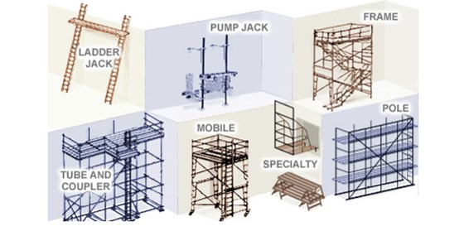
Scaffold types
Supported Scaffold

Slide 40
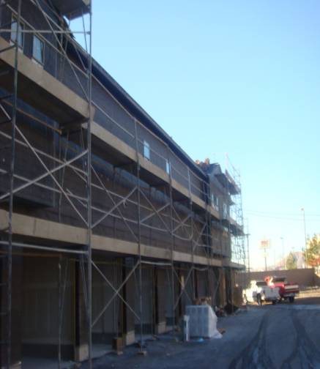
Scaffolds in construction
Avoiding risks
Follow manufacturer's instructions.
Install guardrail systems along all open sides and ends of platforms.
Notes:
Height of the scaffold should not be more than four times its minimum base dimension unless guys, ties, or braces are used.

Slide 41
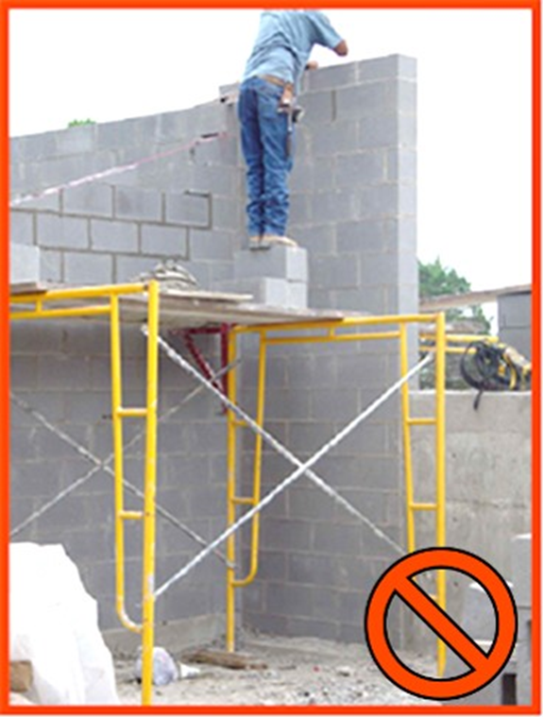
Scaffolds in construction
Never stack blocks, bricks, or use ladders on top of scaffolds for extra height.
Notes:
Toe board is the board used at the bottom side edge of the scaffold. If the material is stacked above it, there is a possibility that the materials will fall below and can hurt the workers worker below the scaffold.

Slide 42
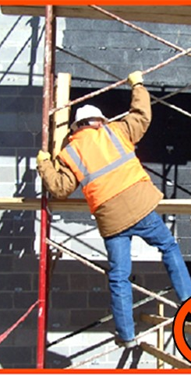
Workers must have a safe way to access the scaffold.

Slide 43
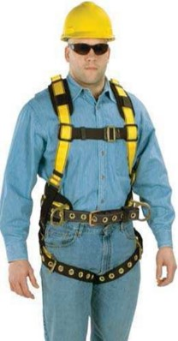
Authorized Person
Authorized Person:
A person approved or assigned by the employer to perform a specific type of duty or duties or to be at a specific location or locations at the jobsite.
This is the “user” of the equipment.
They know what they need to know in order to be able to perform their particular jobs
Notes:
The idea of “authorization” has nothing to do with whether or not someone works for a company. When one walks up to a door and sees a sign that says, “no unauthorized personnel,” this means that only those who are properly trained, not anyone who is an employee, may enter. The same is true for fall protection.
At a basic level an authorized person is someone who knows what they need to know in order to be able to perform a particular job.
If that simply means knowing how to inspect FP equipment and utilize it in an aerial lift, then they must be trained on that (and not on the entire broad spectrum of everything fall protection-related).
Most workers are simply “authorized persons” who have been trained on how to use specific fall protection equipment in specific situations.

Slide 44
Competent Person
Competent Person:
One who
is capable of identifying
[a] existing &
[b] predictable hazards in surroundings or work conditions which are unsanitary, hazardous, or dangerous to employees, and
(2) who has authorization to take prompt corrective measures to eliminate them.
Notes:
Go through the definition piece-by piece:
Identifying “existing” hazards is easy enough (in most cases). Once knowing the 4’ or 6’ number (with the exceptions already discussed), it is fairly easy to pick out many FP hazards that may be present on a site.
“Predictable” hazards are addressed through doing “pre-task planning.” The majority of incidents that result in injury or a fatality happen either because of improper (or lack of) planning (as was the case with “Big Blue”) or because a plan that was established wasn’t followed (as was the case with the young worker who fell through the roof of the sports arena).
The third key part to the definition is that this person has “authorization” to take prompt corrective measures.
Essentially, this is where the job of a competent person could stop (at least per OSHA regulations). They simply need to be able to identify the issue and, then, make sure that the job process is stopped until the issue can be resolved.
However, in many cases it will be them that helps to fix the issue, but the main responsibility is to stop hazardous situations from existing until they are addressed. To do this, they need to be knowledgeable about:
The scope of the hazard;
The regulations in-place pertaining to it;
The controls set-out for them to deal with issues that arise;
The equipment that is available to control hazards, including:
Inspection Points;
Proper Use (such as donning);
Use Limitations

Slide 45
Qualified Person
Qualified Person:
One who
by possession of a
[i] recognized degree,
[ii] certificate or
[iii] professional standing, or
(2) who by extensive knowledge, training, and experience
has successfully demonstrated his ability to resolve problems relating to the subject matter, the work, or the project.
Notes:
The Qualified Person complements the work of the Competent Person. In regards to fall protection, they get involved principally in two main situations:
In cases where the fall arrest anchorage point is questionable in the eyes of the person who is selecting it (i.e. they are not sure that it can meet Option A: 5,000 pounds), this person must get involved in order to help establish whether or not they can meet Option B: Safety Factor of 2 Determined by a Q.P.
The regulations also say that this person must be involved in the design and installation of horizontal lifelines. (Although these haven’t been discussed up to this point, the instructor can quickly touch on what they are just so that the students have an idea. HLLs will be addressed again once getting to the section on “anchorage connectors.)
It should be pointed out that although the OSHA definition technically doesn’t mandate that this be a structural engineer, it will be hard for other types of workers to meet the requirements stipulated.

Slide 46
Fall protection requirement
"Unprotected sides and edges." Each employee on a walking/working surface (horizontal and vertical surface) with an unprotected side or edge which is 6 feet (1.8 m) or more above a lower level shall be protected from falling by the use of guardrail systems, safety net systems, or personal fall arrest systems.
On scaffolds, fall protection is required at 10 feet.

Slide 47
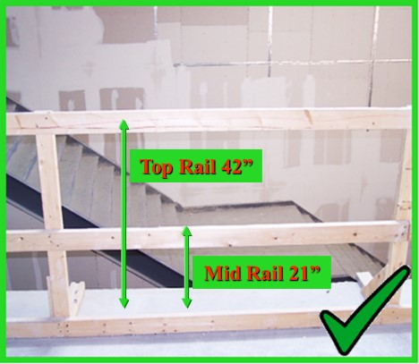
Guardrails
Guardrails must have a top rail, a mid rail and a toe board.
The top rail must be at least 42” from the working surface.

Slide 48
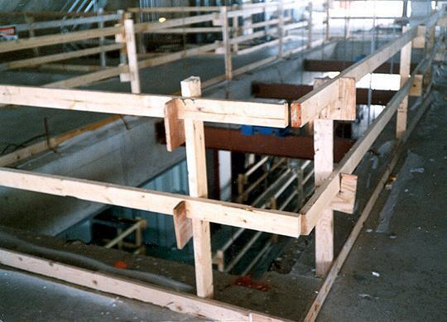
Guardrails
Top Rail
Mid- Rail
Toeboard
Top rails 42 +/- 3 in: between 39 and 45 inches tall
Toe boards at least 3 1/2 inches high

Slide 49
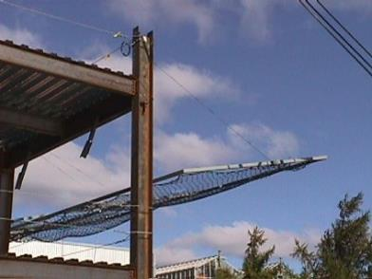
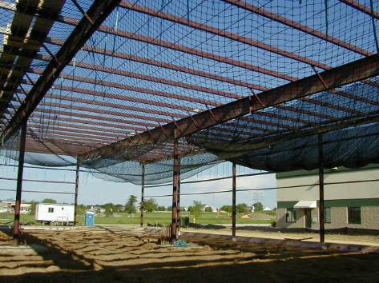
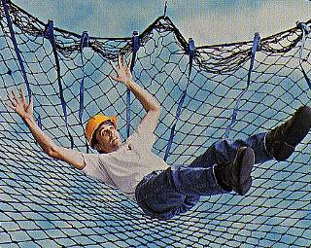
Use of Safety Nets
Assumes the fall will occur
Notes:
The instructor will explain the scenario

Slide 50
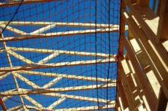
Safety Nets
Not a debris net
This is meant to catch falling people.
Form of collective and passive F.P.
Sometimes used during work on bridge projects or pre-fab building construction
Safety Net in Residential Construction
SafetyRespect® Safety Net System
Notes:
Safety nets for falling people are, essentially, what can be envisioned: they are put in-place to catch the falling worker much like one in a circus act would.
Although not commonly used in the majority of fall arrest situations, there are places where they are pretty frequently used such the situations shown in the pictures on the slide.
They are somewhat commonly used by iron workers during the construction of “pre-fab” buildings as is the case with the leading edge work being done by the worker in the top photograph. Here, individual components of the building itself may not be strong enough to support fall arrest forces, but a net can be used to spread out forces over the entire structure.
A similar situation can be seen with the safety net set below roof trusses on a residential construction job, again for the same reason that a net was used for the pre-fab building.
Sometimes nets will be seen on the edge of tall buildings to catch workers who may fall over the side, similar to what is shown in the “SafetyRespect” system.
One other common location where these are used would be during bridge construction where a lot of worker movement is needed and a PFAS would be too restrictive.
When going with a safety net system, OSHA spells out a number of requirements for construction. In fact, often the cumbersome nature of all of the requirements and the amount of design / testing that needs to go into their use, is what often dissuades companies from using them. That said, if they are going to be used, OSHA lays out some clear rules that must be met. The rules for Construction where they are commonly used are laid-out @ 1926.502(c).
Proposed Subpart D, at reference 1910.29(c), directs G.I. employers to the Construction regulations above for compliance requirements.

Slide 51
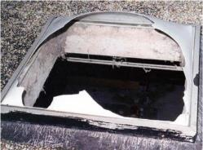
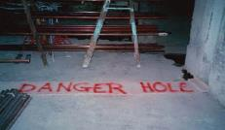
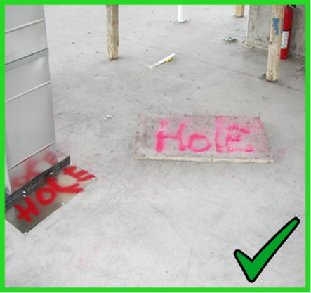
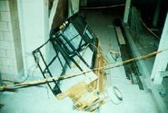
Skylights & Holes
Skylights & Roof Floor Openings
Back / Trip into;
Step on weak area of roof;
Hole hidden by non-load- supporting covering
NIOSH FACE Skylight Fatality
Hole Covers:
Be able to support at least twice the load imposed upon them
Be secured to prevent accidental displacement
Notes:
It should be noted that Subparts D & M consider both regular holes in the floor and “skylights” to be forms of “floor holes,” requiring protection against falling through both.
Floor holes, whether they be cut-out sections of roof / floor or a skylight, actually account for a significant number of fall deaths on an annual basis, both on Construction sites and in General Industry. By far the most common way that workers fall through them is by stepping onto them by accident (backing onto them or stepping on holes covered by an object such as roofing felt that has not been marked to indicate the hazard) or by tripping and simply falling through them.
OSHA lays out requirements for the “covers” that need to go over floor holes in 502 of Subpart M:
Note that requirements for current and proposed Subparts D are essentially the same.
1926.502(i)"Covers."
“Covers for holes in floors, roofs, and other walking/working surfaces shall meet the following requirements:
1926.502(i)(1)
Covers located in roadways and vehicular aisles shall be capable of supporting, without failure, at least twice the maximum axle load of the largest vehicle expected to cross over the cover.
1926.502(i)(2)
All other covers shall be capable of supporting, without failure, at least twice the weight of employees, equipment, and materials that may be imposed on the cover at any one time.
1926.502(i)(3)
All covers shall be secured when installed so as to prevent accidental displacement by the wind, equipment, or employees.
1926.502(i)(4)
All covers shall be color coded or they shall be marked with the word "HOLE" or "COVER" to provide warning of the hazard. Note: This provision does not apply to cast iron manhole covers or steel grates used on streets or roadways.”
The pictures at the bottom show examples of compliance with the regulations laid-out above, except in the case of the third photo where the floor hole couldn’t even support the weight of the load imposed on it, let alone twice it.
Skylight screens are a very common form of fall protection being utilized more and more. Here, although the worker may break the skylight when stepping on it, they will not fall through. An alternative to this is to put guardrails all the way around the skylight, as seen earlier.

Slide 52
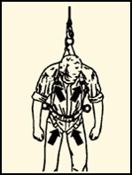
Personal Fall Arrest Systems
Includes an anchor point, a lifeline, and a safety harness
Once a Personal Fall Arrest System has been used in a fall, it must be removed from service right away.

Slide 53
Anchorage Point
Secure location of attachment for the worker’s F.P. gear:
Typical “anchorage / anchor points” include:
Large Columns | Large Beams | Concrete | Roof Panel / Understructure
OSHA Anchorage Requirements:
5,000 lbs.
Notes:
One should begin by explaining that the anchorage, or “anchor,” point is the location to which the worker is going to attach their harnesses to absorb the impact forces of the fall. For that reason, it needs to be a fairly structurally sound member. One way to get workers to begin to understand why anchors need to be as strong as what the law requires (and as will be discussed shortly), is to give a hypothetical scenario.
Give workers the hypothetical scenario that there is a beam that can support 1,000 pounds but which will break if subjected to 1,001 pounds. Tell them that a worker who weighs 310 pounds (their own weight plus tools) will fall into it utilizing a cable connection (no energy absorber) a distance of just six inches. Signal this distance for effect.
Ask whether, at face value, common sense tells them that 310 pounds free falling 6” would be enough to cause the beam to fail.
This test has, in fact, been done and can demonstrate that a drop of 6 inches of a 220 pound rigid weight (once the ANSI suggested equivalent to simulate a 310 human being, (now being 282 pounds instead) will produce a force of nearly 1,300 pounds, which would obviously cause the beam to break.
Students find it interesting that each time they take a step down a set of steps their legs, which are operating to stop “controlled falls,” are absorbing more than a ½ ton of force upon contact with the next step.
Indicate that often anchorage points that will be selected will fall into one of the categories of what is listed in the various bullet points. Occasionally students will wish to be given guidelines as to what measurements on different types of points will make them adequate for fall arrest, but it should be indicated to them that the calculations are not this simple. Much goes into determining the force that different points can support when a qualified person is running the numbers:
What is the size of the anchor?
What is its condition?
What is the distance between its nearest supporting members?
How much load (if it is a roof member, for example) is it already supporting?
And although there are some companies that actually do give guidelines to workers when selecting anchorage points (the pipe must be of such and such diameter with a span between supports of no more than…, for example), this is not the norm nor is it the intent of the class. Instead, the general OSHA requirements will be described and the topic left at that.
When it comes to the OSHA requirements, both Subpart M and Proposed Subpart I give two options. The first of these is that the anchorage point needs to be capable of supporting a straight static load of 5,000 pounds. The law does not require that it actually be tested to this force but, instead, says that a worker should select something that would theoretically be able to support this load.
A common visualization that can be used to determine whether or not a something should be able to support this load is if the worker thinks that the item to which they would like to attach would be able to suspend a regular size truck, such as a Ford F-150 or a Chevy Silverado. If they think that the truck would pull it down, it will not work. On the other hand, if they think that it could support the truck, they would have to be severely mistaken (be off by more than 3,000 pounds) in order to be in danger. This will eliminate connection into many of the small objects into which people connect if they are honestly and truly doing this mental visualization.
The second option that OSHA gives is that the anchor needs to be able to support at least double the forces that will be put into it in a fall, giving a “safety factor of 2.”
Discussing this can be set up by mentioning a French study referred to by ANSI where forces in the range of 2,500 to 2,700 pounds were found to be high enough to cause significant injury to the body due to jarring of internal organs and leading to internal (potentially fatal) bleeding.
Thus, both the US and Canada have determined that systems shall be designed to stay well away from this force, arriving at what is known as a “Maximum Arrest Force” permitted of 1,800 pounds. The key point here to note is that in most fall arrest system setups, especially simple ones where the worker is attached to a rigid structure via harness and lanyard or SRL), the force that is imposed on the worker is the same that will be imposed on the point itself.
From this, many engineers (being qualified persons) will take the 1,800 force indicated as the maximum force imposed on the worker’s body on a fall and double it for what the anchorage must be able to hold. This determination, however, is very simplistic and can vary from situation to situation, serving simply as an example that is often used for anchorage points that may not be able to meet the 5,000 pound requirement but which can be certified to a safety factor of 2.
A few further notes on the two options can be spelled out at this point:
First, “Option A” is the most common one that is utilized, most likely because it doesn’t specify who has to make the determination. Essentially, any authorized person out on the job site can make the determination of whether or not they think the point into which they would like to connect could theoretically hold the required force. For this reason, this type of anchorage point is known as a “non-certified” anchor.
By contrast, Option B spells out that the determination needs to be done by a Qualified Person. These types of anchorage points are much less common, but they are preferred by some safety people because at least someone has analyzed the point and determined it to be safe for fall arrest forces (something which cannot always be said about points selected to meet Option A). Often, these anchorages will be tagged or color-coded to indicate that they have been analyzed and determined to be used for fall arrest purposes only. These anchorages are known as “certified” ones.
Regardless of which is selected, the requisite force needs to be multiplied by the number of workers attached to it. Therefore, if two workers are attached to the same beam and utilizing the 5,000-pound option, the beam needs to be able to now hold a static load of 10,000 pounds to meet the requirement. (This would go for Option B, too.)
A final note to discuss here is that the law talks about “Maximum Arrest Force,” something some people sometimes call “Maximum Allowable Force.” It could be pointed out that in the past many pieces of equipment used to say “Maximum Arrest Force” with a number of 900 lbs. and not 1,800 pounds. This meant that when using the equipment properly it would only subject the worker to ½ the limit that the law permits. However, when ANSI went from the 220 lb. test weight to the 282 lb. one, labeling of this type went out the window. Some points can be taken from this:
There was a time when some equipment was designed using Option B with a safety factor of 2 multiplying 900 lbs. times 2, for a total strength of 1,800 lbs. Granted, not a lot of engineers were comfortable with this, but it was technically legal.
Now, equipment will often say “Average Arrest Force (AAF),” listing a number of 900 lbs. in many cases. This means that we know that on average the force will be at 900 lbs., but there will likely be a peak above this (due to the heavier weight and greater resultant force in a 6’ drop). Thus, engineers cannot go by the 900 number any longer because they have to double the maximum arrest force, not the average arrest one. Thus, 1,800 pounds is the one number that we know will not be surpassed when equipment is correctly used.

Slide 54
Temporary Anchorage Connectors
Notes:
These anchorage connectors are used in a temporary fashion, only to be removed to other work locations once finished in a particular spot.
This is a mandatory slide just to show some of the types of anchorage connectors available through MSA and Latchways. The preference is to have as many of these as possible in kits to hold up physically and show to the class, but these slides can be utilized as a basic supplement if none are available, just to put a picture to what is being talked about.
In addition, a booklet of user guides for MSA’s different products will be put together. This is something that should be studied at a high level to come to understand some of the main requirements for different pieces of equipment. It is relatively rare, for example, to be asked for strength requirements of the concrete into which a MEGA Swivel will be connected, but the more the instructor knows about these pieces of equipment the better.
Information on the actual pieces shown here is as follows:
Double D-Ring Anchorage Connector Strap
Standard lengths of 3 ft., 4 ft. and 6 ft.
Comes with an integral wear pad
Anchorage Connector Strap w/ Sewn Hoop on End
Here, the strap is choked through a web loop as opposed to passing a small D-ring through a big one to make the connection.
There are different versions of this strap, but the common length suggested in the catalog is 5’.
Thermatek Anchorage Connector Strap
Kevlar webbing and stitching
Includes a replaceable wear pad to protect webbing from abrasion
Is heat and burn resistant
Anchorage Connector Chain
Useful near sharp edges or in high-heat environments
Not Included (but in Catalog)
Suretyman Anchorage Sling -
1” nylon tube webbing sewn into a continuous loop
Available in 2 ft., 4 ft. and 6 ft. lengths
Can be hitched to an anchorage point using various configurations
Anchorage Cable Sling -
Standard lengths of 2’, 4’ and 6’ or custom
Vinyl coated
¼” Galvanized Cable
This one, per engineering, is only recommended when utilized overhead or with a HLL so as to keep a load on it at all times. This is because the carabiner or snaphook (a large one is suggested) connect in a “basket” fashion to the Flemish eyes. What can happen is that in other configurations (where there is slack) the eye can actually work to open a carabiner gate or put force on a snaphook gate in a fall.
Anchorage Connector Extension
Vinyl coated
¼” Galvanized Cable
Standard 5’ length
Here, the cable is wrapped around the anchorage point, connecting the snaphook of the device into the round ring. Then, the worker connects their connecting device snaphook to the round ring as well. (This may be the only product where MSA allows two snaphooks connecting into the same ring at the same time…but it is the prescribed use.)
Workman FP Stryder
Low friction wear pads with Teflon® enable effortless gliding along beam flange
An integral load indicator alerts the user if the unit has been exposed to a fall
Is designed to mount either overhead or at the worker’s feet. (It, however, cannot be used in a vertical fashion.)
There are rough and fine adjustment tabs on the Stryder.
The “rough” adjustment notches should be adjusted first and, then, the fine adjustment ones on the opposite side to ensure proper fit and connection onto the beam flange.
400 lb. working capacity
Workman® Reusable Roof Anchor
Fits up to a 12 x 12 roof pitch
Removable Concrete Anchors & MEGA Swivel Hybrid
RCA
Quickly and easily removed and reinstalled in another location
Durable stainless steel and aluminum construction
400-lb capacity
2 models:
5,000 lb. version (5K)
10,000 lb. version (10K)
The latter is larger than the other
The 10,000 lb. version can be used to anchor MSA Dyna-Line or Sure-Line HLLs as well as Gravity HLLs
MEGA SWIVEL HYBRID
Max capacity: 10,000 lbs. (44 kN)
Designed for repeated use; durable and 100% retrievable

Slide 55
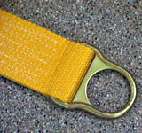
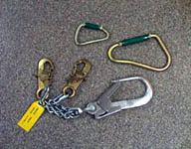
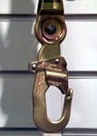
Connectors
Connectors
D- Rings
Snaphooks

Slide 56
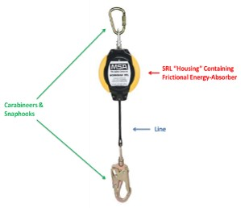
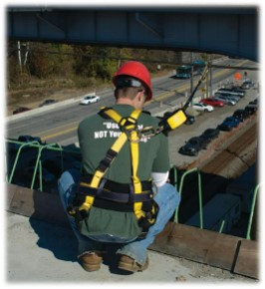
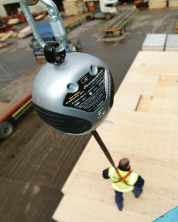
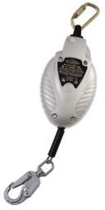
Connecting Devices
Self-Retracting Lifelines
Drum-wound line is slowly extracted from or retracted back into the housing in normal use
Like a car seatbelt, locking off in a fall
PFL
Web SRL
Notes:
This is another area where demonstrating with physical examples is more useful than a slide, but having the slide helps to show some real-world examples.
SRLs depend on “pawls” on the inside that are held in-place by small springs. When the drum is spun fast enough, the retention force of the small springs is overcome and the pawls are allowed to flip out, locking into the housing of the unit and activating its deceleration / braking mechanism.
Many people are under the false impression that when it locks off, that is where the unit will stop paying out line. This, however, is not the case. Instead, depending on the unit, some energy absorbers will be visible on the outside in the form of a pack and others will be internal, utilizing brake pads like on a car on which the drum will turn or a more simple system of where the internal parts of the unit will compact down, absorbing force and paying out additional line. Latchways, as will discussed shortly, has still even more technologies to accomplish the same feat.)
The concept of “PFL” versus “SRL” needs to be discussed.
When “self-retracting lifelines” (SRLs) first came out they were big and bulky and, thus, were meant to be hung from an anchor point with the line hung down to the worker to connect into the back of their harness.
However, with time smaller and smaller units were designed and the concept of actually wearing them on one’s back like a lanyard was developed, thus creating the concept of a “personal fall limiter,” (“PFL”).
With these devices, the idea is that they can simply be worn at all times like a lanyard but they give the benefits of only having the needed line extracted when in use, thus limiting how far the worker goes in a fall (as opposed to a fixed length lanyard).
It should be noted that PFLs can also be turned around and utilized as regular SRLs should the user so desire, as it will not affect how they function at all.
SRLs go by various names including, “retractables,” “blocks,” and “Yo Yo’s,” among others.
The idea with the picture of the rope is to indicate that when SRLs are hung overhead, there are two major rules that must not be violated:
First, when the line is not being used, it must not be tied at the base of a ladder, for example, so that it is easily retrieved by the next worker who needs to climb the ladder later on.
This is not only because (a) the line will be left and possibly exposed to harsh elements but also (b) because tension will be kept on the internal retraction spring of the unit, thus weakening it over time due to the constant pressure on it; if this practice continues over time, eventually the unit will not retract line.
For this reason, when the system is not in-use a “tag line” must be used (attached at the snaphook and taken off when in-use) to pull the snaphook down out of the housing of the SRL to ground level where it can then be attached to the worker’s harness.
The second thing to discuss is that when allowing line back into the unit it should be done slowly as opposed to just allowing the line to shoot back up into the unit under spring power. If the user just lets go of the line instead of feeding it back in slowly with the tag line, it will cause the drum to accelerate enough that in some cases it will continue to spin once the snaphook has reached the housing, “backlashing” the spring and effectively making the unit useless.
Backlashing is where the connection between the drum of the SRL and the spring, which is a tab from the spring going into a “drum axle,” basically bend and break apart, thus disengaging the spring and making its retraction function not work anymore.

Slide 57
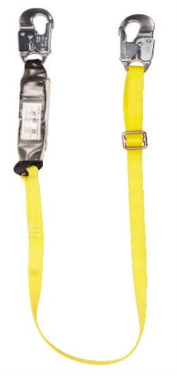
Lanyards
Inspections should be recorded in log
If past prescribed inspection interval, mark as “unusable.”
Many inspection points are similar to those on a harness.
Lanyard Inspection Points:
Hardware
Energy-Absorber
Webbing
Tags
Stitching
Notes:
The best way to handle inspection on pieces other than a harness (which likely was already covered prior to the donning exercise) is first to indicate that inspection criteria here will be very similar, except for where there are new elements not found on a harness.
Start by picking up a lanyard and discussing snaphook inspection:
They must meet all of the criteria met by other hardware pieces (i.e., no red rust that cannot be easily cleaned off lightly with a light wire brush, no pitting, no cracks, etc.) in addition to the fact that they must meet functionality criteria:
First, the snaphook or carabiner gate must not open unless the locking mechanism de-activated. (It must ride up against the nose of the snaphook with very little play, certainly with no daylight being able to be seen between it and the nose.)
Once opened, it shall automatically close on its own. If it doesn’t, MSA does indicate that a light penetrating oil (such as WD-40) may be used to make it operate smoothly again.
No broken parts are acceptable. This would include broken rivets or a broken gate spring.
Once having covered this, pass down the rest of the length of the lanyard and indicate how the inspection criteria will apply identically to how it did with a harness.
With tubular style (Diamond) lanyards, indicate that the folds must all be pulled apart when inspecting to look down in for cuts, tears, and abrasion.
These folds often will catch weld slag / sparks and allow them to sit and smolder; thus, care must be taken to inspect the areas in-between the folds carefully.

Slide 58
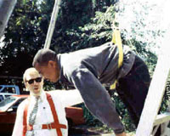
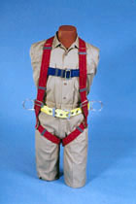
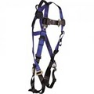
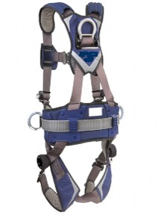
Body Harness

Slide 59
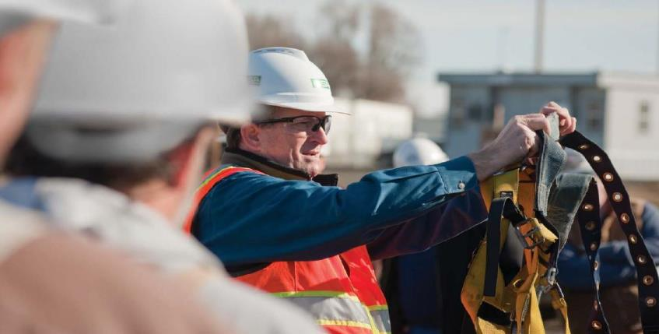
PFAS Inspection

Slide 61
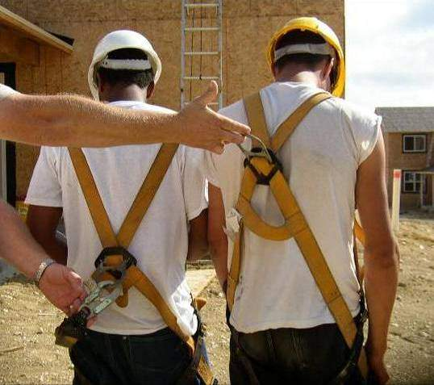

Slide 62
Connecting Devices
Notes:
This and the slides that follow it, like anchorage connectors, are best left just to catch items missed during a hands-on visual demonstration of a lanyard for the class at the front of the room. As with a harness, a lanyard should be selected and discussed piece-by-piece.
Start by discussing the snaphooks of the lanyard, explaining that they come in a variety of materials (carbon steel w/ zinc chromate plating, stainless steel, aluminum) as well as sizes (³/₄" & 2 ¼” openings). The larger snaphooks are known by many different names, including “rebar hooks,” “pelican hooks,” and “ladder hooks,” among others.
Note that the large rebar hooks are made to connect onto larger objects, with rebar being a prime example of what they were originally designed for but also being used in many other applications where the smaller sized snaphook would not fit such as over the tube on tube and coupler scaffolding for scaffold builders / those working on a scaffold where part of the railing has been approved as a connection point.
Although not officially noted in MSA literature, the rebar hook should not be attached to the dorsal D-ring of a worker’s harness.
Snaphook compatibility discussions are a good place to discuss the OSHA requirement for double-action locking mechanisms on all snaphooks and carabiners.
Discuss how prior to 1998 non-locking snaphooks were available and simply had a spring loaded gate.
Using a “compatibility simulator” the instructor can hook up to an incompatible connection point (a simulated eyebolt) and explain that the students should, for a moment, assume that the anchorage is good for 5,000 pounds, the snaphook itself is rated for 5,000 (as the body itself was), and the line on the snaphook is good for more than that.
Then, having twisted the snaphook so as to have it oriented so that force can be put on the gate, pull down and demonstrate how “roll out” could occur where the snaphook could easily come off. (There have been anecdotal stories of workers in aerial lifts who were attached and working at the opposite side of the lift, pulling on their lanyard, only to have it come off in this way prior to the OSHA law changing. Thus, they’d become disconnected from their anchorage point and not even know it.)
Discuss how OSHA now requires an auto-locking feature (this prohibits screw-lock carabiners) on both snaphooks and carabiners, which means that at least two deliberate actions will need to be taken to open the connector.
Put an OSHA-compliant snaphook on the incompatible eyebolt, twist it, and show that it will not come off. But, ask if there is still a problem.
Try to see if you can get the students to see that pressure is still being put on the gate and see if anyone questions how strong an OSHA-compliant gate is.
Generally, they are strong enough to withstand 220 pounds from the front and 350 pounds exerted on them from the side.
Seeing that fall arrest systems won’t even begin to dissipate fall forces until reaching around 900 pounds and that high forces are generated in even a 6” drop, this strength will not be sufficient to hold if such forces are imposed. Thus, the issue that arises is what is known as “burst-out” where the snaphook gate simply fails due to the high forces.
Indicate that the issue was not one of locking versus non-locking but, rather, one of compatibility. There are three ways to determine compatibility:
First, a general rule is that if the snaphook or carabiner is bigger than the connector to which it will be connected and will not pass through inside of it, it is not compatible.
A second rule is that when the snaphook or carabiner is connected to the closed connector (with a D-ring probably being the most common example), one should not be able to cause the body to touch the opposite side of the connector by pushing on it.
Perhaps the most important way to determine compatibility or not is to attach the snaphook / carabiner to the connector and see if there is any orientation where it could sit / lay / be pushed where the gate could be loaded in the case of a fall. If so, it is incompatible. If, however, no amount of twisting or maneuvering could put force on the gate, it is compatible.
Indicate that MSA also has a whitepaper on compatibility that states the following:
“This technical brief is intended to address the question of compatibility of MSA fall protection products with fall protection products of alternate brands. MSA user instructions may state that any mixing of different brands must be approved in writing by MSA. The stance described in this technical brief supersedes the requirement for written approval by MSA.
It is acceptable to mix fall protection equipment of different brands provided the following
requirements are met:
All fall protection equipment used by an individual must meet the same industry standard or government regulation; either ANSI, CSA, EN or other applicable standard or regulation.
The fall protection equipment selected must be third party certified or independently verified to comply with the standard / regulation.
The competent person designated by the user’s organization or a qualified person must evaluate the components and determine that they are compatible for use based on capacity, size, strength, and shape of connecting elements.
Contact MSA with any additional questions regarding compatibility of equipment.”
A topic that ties in nicely at this point is snaphooks and carabiners that meet the ANSI Z359.1-2007 standard that requires that the gates be able to withstand a 3,600 pound force in any direction.
Describe how this is more than sufficient to hold in the case of a fall where the gate is loaded (seeing that maximum arrest forces shall not be more than 1,800 pounds when an appropriate fall arrest system is used correctly) but that it is still not a license to hook to incompatible anchorage connectors. Instead, describe it as a second line of defense for the case where a user makes a mistake or a bad decision.
Snaphooks and carabiners that meet this standard are easy to identify as they have the 3,600 pound strength marked on the gate.

Slide 63
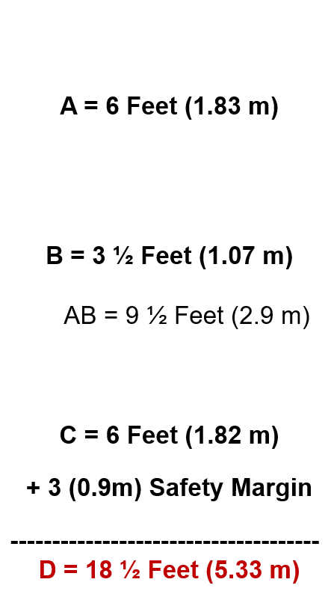
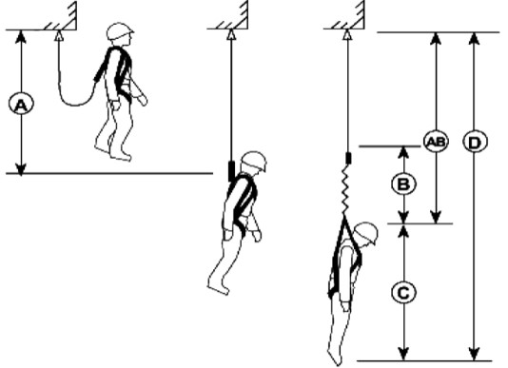
Fall Clearance - Lanyard
Safety Margin: 3’
Notes:
Explain that there will always be two steps to calculating fall clearance for an energy-absorbing lanyard.
The first step is to measure from the ground (or closest obstruction below) to the bottom of the anchorage point and get a number.
For this chart, say that they have done so and come up with 20’. This tells them how much clearance is available for the fall.
The second step is to add the variables that are shown on the right side.
Indicate that in this diagram a D-ring anchorage connector is being used and, thus, its length hanging below the bottom of the anchorage point being negligible has been left off.
That said, ask if they think they’d need to add 2’ for a cross-arm strap that hangs down two feet below the beam. (The answer is yes.)
To this, add the length of the lanyard (which is usually 6 feet but, which, can vary), its elongation (another variable), the height of the worker (another variable, although 6’ is the common number suggested to use by MSA), and an additional safety margin of 3’.
Ask why they think the safety margin is necessary. Responses should include:
Stretch in the harness (which they will have seen during the lift exercise);
Possible errors in calculations
Once everything is totaled, in this case the worker’s system requires 18 ½ feet so that he won’t hit.
Tell the students that as long as the measurement that was done on the left (from the ground / nearest obstruction below to the anchor) comes up with a bigger number than the addition of the variables to the right, they are fine for clearance.
Next, to see if they really have the concept, ask the students how clearance would change if the worker were to use the same attachment point but climb atop his anchorage and his current work platform were to disappear.
Some students will say that more clearance will be needed while others will stay that it should stay the same. Help them understand the concept that more clearance is not needed by asking the following questions:
Has the distance from the ground to the anchor changed? (No)
Is the length of the lanyard different? (No)
Will the deceleration distance be longer from one traditional, OSHA-style 3 ½’ rip-out lanyard to another? (No. It cannot be. They will go all the way through the energy-absorber and hit into the back-up strap, but will only go a negligible amount further.)
Ask them if the height of the worker has changed. (No)
Ask if the safety margin has changed. (No)
Then, you can say, “When it comes to calculating fall clearance, the height of the worker is not important. What is important is the height of the…” (and they almost unanimously are able to say “anchorage point”).
Note that some workers will recognize that the worker standing atop the beam will see higher free fall and fall forces because of this setup. Acknowledge that this is an issue of significant concern, but that it is not a fall clearance issue.
Activity Suggestion:
A very good way to demonstrate this is to lay indicate an “anchor point” on the floor, lay out a completely deployed lanyard, and measure out an additional 8 ½ feet with a tape measure just to show just how much distance this really is.

Slide 64
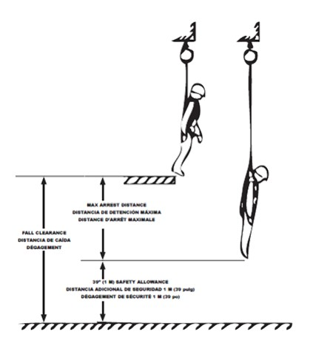
Fall Clearance - SRL
A Typical Example
MAD = 4 ½ Feet (1.37 m) + 39” (1 m) Safety Margin ------------------------------------- D = 7’9” Feet (2.4 m)
Max Arrest Distance
Fall Clearance
Safety Factor of 39”(1 m)
Notes:
Explain that fall clearance with an SRL or with a PFL is figured out differently from the process that was followed with lanyards.
Here, we often don’t know the length of the payout of the line, especially in the case that a large SRL is being used; it may have a total length of 17 or 20’, for example, and we may not know what the exact length is.
Here as new way to calculate fall clearance was created where instead of measuring from the ground to the bottom of the anchor we simply measure from the ground to the work surface, thus eliminating the need to know the length of the connecting device as well as the height of the worker.
Now, in a best case scenario where the worker is anchored above them and is standing, we simply need to know the labeled MAD and the safety factor, here for a grand total of 7’8”.
Note that some workers will have a difficult time understanding why the worker’s height doesn’t need to be considered.
This can be explained by discussing how if they were to step off the beam instead of falling they would simply go the distance allowed by the SRL / PFL. Thus, at a maximum, they would only go 4 ½ feet before coming to a stop after having left the work surface.
Explain that since the measurement was from the ground to the work surface, nothing above the work surface needs to be measured.
If necessary, demonstrate with a ruler or pen up against the project screen to fill in for the roll of the falling person.
Not all situations will be best case scenario, however. Remind workers that if their anchor point is not elevated but is, for example, at the height of their back D-ring, they will have to add the length of the SRL / PFL as an additional “free fall” variable on top of the MAD.
Note that on all MSA SRLs and PFLs, MSA puts a limit on allowed free fall to 2 feet.
The only exception to this rule when it comes to any retractable is with the MSA Mini PFL, which allows anchorage up to a maximum of 5’ below the worker’s back D-ring.
Another issue is if the worker is to kneel down or lie on their stomach.
In these cases such as this, it is the MSA stance that the worker needs to add an additional 3’ for the worker who is kneeling and their height if they are on their stomach. This is because now their body is starting from a different position and will straighten out vertically when they fall, thus requiring the additional clearance.
Again, this may be a difficult concept for students to visualize. If so, take a pen / ruler and put it up on the screen and indicate the starting position of the fall, how the body will straighten out, and how this will now require taking into account the unfurling of the body.

Slide 65
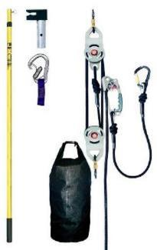
Rescue Equipment
Rescue Cradle
Person is rescued in a physically neutral position.
Full Body Harness
May be different
Allows longer suspension
Anthron
Self-Rescue
Great in a panic
Rescue Equipment Kits
Rescue Utility Set
Rescue Hoist
Confined Space Application
Able to reset

Slide 66
Fall Rescue Procedures
If the worker may be hurt, call 9–1–1.
Figure out the best way to rescue the fallen worker.
Locate the nearest rescue anchor
Look for the nearest safe working level for the fallen worker
Identify equipment needed to get the fallen worker to a safe working level
Notes:
Explain what a rescue anchor is.

Slide 67
Questions?

Slide 68
Disclaimer and Copyright Information
This material was produced under grant # SH-31201–SH7 from the Occupational Safety and Health Administration, U.S. Department of Labor. It does not necessarily reflect the views or policies of the U. S. Department of Labor, nor does mention of trade names, commercial products, or organizations imply endorsement by the U. S. Government. The U.S. Government does not warrant or assume any legal liability or responsibility for the accuracy, completeness, or usefulness of any information, apparatus, product, or process disclosed.
This material is the copyrighted property of Florida International University. By federal regulation, OSHA reserves a license to use and disseminate such material for the purpose of promoting safety and health in the workplace. Florida International University hereby authorizes employers and workplace safety and health professionals to use this material, distributed by or through OSHA, in their workplaces or practices in accordance with the guidance contained in the material.
To this end, permission is granted to use such copyrighted material solely for non-commercial, instructional, personal, or scholarly purposes. The material may be used and incorporated into other workplace safety and health programs on the condition that no fee may be charged for the subsequent use of the material. Use of the material for any other purpose, particularly commercial use, without the prior, express written permission of the copyright owner/s is prohibited. Furthermore, any modification to the material is prohibited without the prior, express written permission of the copyright owners.

Slide 69
Fall Prevention Options
Platforms and Railings
Lifts
Scaffolding
Ladders
Fall Restraint Systems
Mobile Stairs

Slide 70
Commonly Used Terms
FALL RESTRAIN
Prevents people from reaching a fall hazard through a tie off system.
FALL ARREST
Stops a fall that is in progress through a tie off system.

Slide 71
Personal Fall Arrest System
Bodywear
Connecting Device
Anchorage Point
& connector
Rescue
Notes:
-This is simply an introductory slide to show that there are three components to the system itself, each of which will be covered in their own turn, plus the element of rescue that always must be considered but is often neglected during the planning phases of using the PFPS (Personal Fall Protection System). This is a good time to stress for the first time that if one is going to take the time to put all of the other components together and use them correctly they still must consider this 4th, extremely important aspect. A question that can be asked in this regard is, “When is the right time to plan for rescue?” The answer should always come back that it is “prior to the work beginning in the first place.” If it cannot be determined how the rescue will be carried out, work should not even start in the first place.

Slide 72
Examples of PPE Failures
Heat damage

Slide 73
Examples of PPE Failures
Damage due to spark or heat – surface damaged
Buckling damage

Slide 74
Scaffolds in construction
Suspended Scaffold

Slide 75
Scaffolds in construction
Aerial Lift Scaffold

Slide 76
Is This a Fall Hazard?
YES
Workers are exposed to a fall hazard greater than 6 feet, while working near stairwell opening.
Workers must be protected from falls over 6 feet.
Notes:
Worker working above ground level.

Slide 77
Is This a Fall Hazard?
YES
Workers are installing a new metal roof without fall protection.
NOTE: Remember that ladders must extend 3 feet above the landing area.
Notes:
Workers are installing a new metal roof.

Slide 78
Is This a Fall Hazard?
YES
Planks appear to be overloaded and there is no safe access for workers.
Lack of fall protection for workers on fabricated frame scaffolds.
The workers are exposed to a 35-foot fall hazard from a scaffold while stacking blocks prior to overhand bricklaying operations.
Notes:
Workers on fabricated frame scaffolds stacking blocks.

Slide 79
Is This a Fall Hazard?
Notes:
Worker working on an 8:12 pitch roof with the lifeline tied to his waist as fall protection.

Slide 80
YES
Worker working on an 8:12 pitch roof with only the lifeline tied to his waist as fall protection.
Employer must provide full body harnesses.
Notes:
Employer must provide full body harnesses.

Slide 81
FALL PROTECTION Post-TEST
In general, fall protection must be provided to construction workers who are working on surfaces with unprotected sides and edges which are ____________ above the lower level.
(a) 3 ft.
(b) 4 ft.
(c) 6 ft.
(d) 8 ft.

Slide 82
The correct answer is:
(c) 6 ft

Slide 83
2. What are the ways an employer can protect workers from falls on site?
(a) Guardrails, safety net systems and safety belts
(b) Guardrails and safety net systems
(c) Guardrails, safety net systems and personal fall arrest systems
(d) Top rail, middle rail, toe board

Slide 84
The correct answer is:
(c) Guardrails, safety net systems and personal fall arrest systems.

Slide 85
3. A personal fall arrest system consists of:
(a) An anchorage and a body belt
(b) An anchorage, lanyard and connectors and a body belt
(c) An anchorage, lanyard and connectors and a full body harness
(d) A full body harness and a lanyard

Slide 86
The correct answer is:
(c) An anchorage, lanyard and connectors and a full body harness.

Slide 87
4. After a fall accident occurs, the first step to take is:
(a) Report orally to OSHA
(b) Fill the 300A form
(c) Videotape the scene
(d) Implement the emergency procedure that best fits the situation

Slide 88
The correct answer is:
(d) Implement the emergency procedure that best fits the situation.

Slide 89
5. If you are asked to perform a job that you feel is unsafe, you should do it anyways because you might get fired otherwise.
True
(b) False

Slide 90
The correct answer is:
(b) False

Slide 91
6. Employee may file a complaint with OSHA under Section 11(c) if your employer retaliates against you by taking unfavorable personnel action because you engaged in protected activity relating to workplace safety and health. OSHA requires that complaints must be filed within ____ after the alleged retaliation.
(a) 3 days
(b) 7 days
(c) 30 days
(d) 90 days

Slide 92
The correct answer is:
(c) 30 days

Slide 93
7. One who, by possession of a recognized degree, certificate or professional standing or by extensive knowledge, training and experience, has successfully demonstrated his ability to resolve problems relating to the subject matter, the work or the project is called a ________
(a) Authorized Person
(b) Competent Person
(c) Qualified Person
(d) Smart Person

Slide 94
The correct answer is:
(c) Qualified Person

Slide 95
Thank You For Attending!
Questions

Slide 96
PLEASE FILL OUT EVALUATION Scan the qr code

Slide 97
Thank You
972-786-0909
www.regionalhca.org

